Slide 1
Module 2: Understanding Substance Use Disorders, Treatment, and Recovery
Child Welfare Training Toolkit

Slide 2
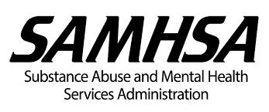
Acknowledgment
A program of the Substance Abuse and Mental Health Services Administration (SAMHSA) and the Administration for Children and Families (ACF), Children’s Bureau
www.ncsacw.samhsa.gov | ncsacw@cffutures.org
Notes:
This toolkit was developed by the National Center on Substance Abuse and Child Welfare (NCSACW), an initiative of the Department of Health and Human Services jointly funded by the Substance Abuse and Mental Health Services Administration's (SAMHSA) Center for Substance Abuse Treatment (CSAT) and the Administration on Children, Youth and Families (ACYF), Children's Bureau's Office on Child Abuse and Neglect (OCAN).

Slide 3
Learning Objectives
After completing this training, child welfare workers will:
Identify the types of substances and their effects, including methods of use
Outline the continuum of substance use disorders as mild, moderate, or severe
Understand the basic brain chemistry of substance use disorders
Recognize the signs and symptoms of substance use in the context of child welfare practice
Discuss substance use disorders in a cultural context
Identify treatment modalities and the continuum of care
Understand the recovery process, relapse prevention and long-term recovery maintenance
Notes:
The goal of Training Module 2 is to educate child welfare workers about substance use, treatment, and recovery. The module informs child welfare workers about substances and their effects, the brain chemistry of addiction, and the continuum of substance use disorders – mild, moderate, and severe - explaining the signs and symptoms and their effects on children and families. This module provides an understanding of the treatment and recovery processes, and specifically how substance use disorders can affect family relationships and dynamics of the families involved in the child welfare system. The information and learning opportunities are designed to support family-centered child welfare practice with families from diverse cultural groups.

Slide 4
Collaborative Values Inventory
Strongly Disagree
Disagree
Neutral or Unsure
Agree
Strongly Agree
In different circumstances, any person could be a parent with a substance use disorder
A person with a substance use disorder should not be held accountable for his or her negative behavior
If parents with substance use disorders had enough willpower, they would not need substance use disorder treatment
The stigma associated with substance use disorders prevents parents from seeking treatment
(Children and Family Futures, 2017)
Notes:
Differences in values among participants are important to recognize because they may come up in the training and with the families participants are working with. These questions can be asked at the beginning of the training to help understand the different values and perspectives participants bring to the training. Have a brief discussion with participants on how their individual values can affect their work with families.
***Review the slide questions from The Collaborative Values Inventory, a validated tool that assesses how much a group shares beliefs and values that underlie its work. Participants can share their experiences or keep their answers private. Discussion should be limited to understanding value clarification, instead of debating individual answers to questions. Participants will fall along a continuum.

Slide 5
Individual Factors That Increase Risk for Substance Use or Misuse
Developmental
Environmental
Social
Genetic
Co-occurring mental disorders
(U.S. Department of Health and Human Services, 2016)
Notes:
Now we are going to discuss what factors increase risk for a substance use disorder.
Not everyone who uses substances will develop a substance use disorder.
There are developmental, environmental, social, and genetic factors that affect whether and how a person develops a substance use disorder.
Every person has unique combinations of risk and protective factors, which form a complex interplay that will affect the probability that that person will use or misuse substances.
Early childhood experiences can increase the risk of developing a substance use disorder. A range of experiences include physical, emotional, and sexual abuse; neglect; household instability such as parental substance use; mental disorders or incarceration; and poverty. Initiation of substance use in adolescence also leads to an increased risk of later development of a substance use disorder.
Substance use and mental disorders often co-occur. For example, there is a high prevalence of alcohol use disorders among people with a diagnosis of post-traumatic stress disorder (PTSD).
There are a number of theories about why substance use and mental disorders co-occur:
People with mental disorders may use substances to help cope with the symptoms of their disorder.
Substance use disorders may also lead to mental disorders by changing the way the brain functions.
People who are at higher risk of developing a substance use disorder may also be at an increased risk of developing a mental disorder, based on genetic factors or life experiences, and vice versa.

Slide 6
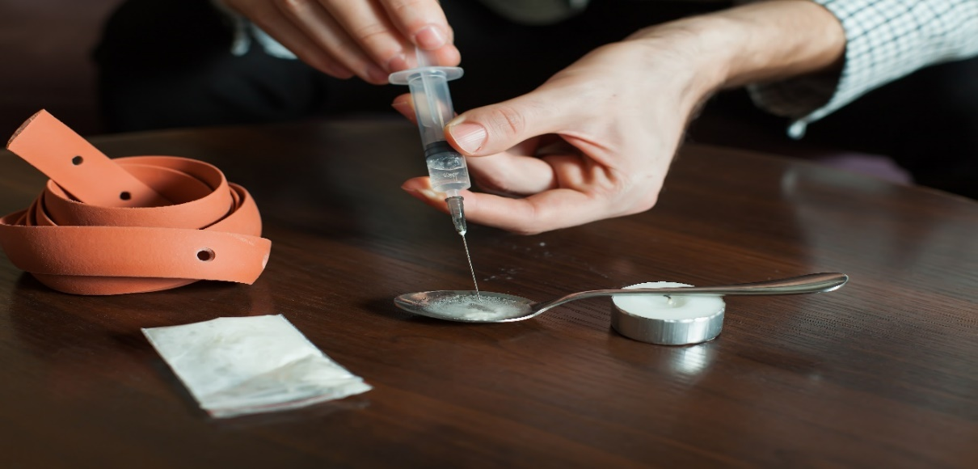
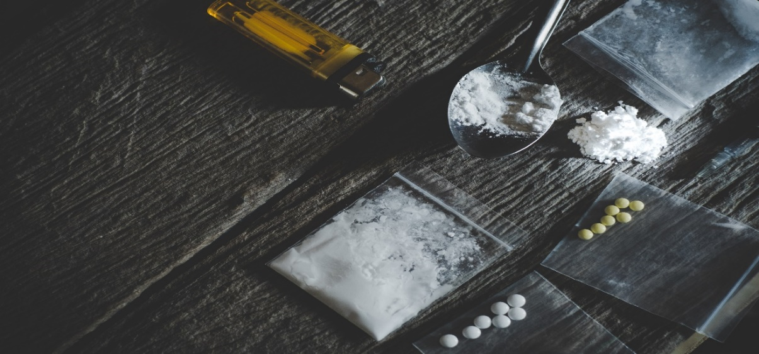
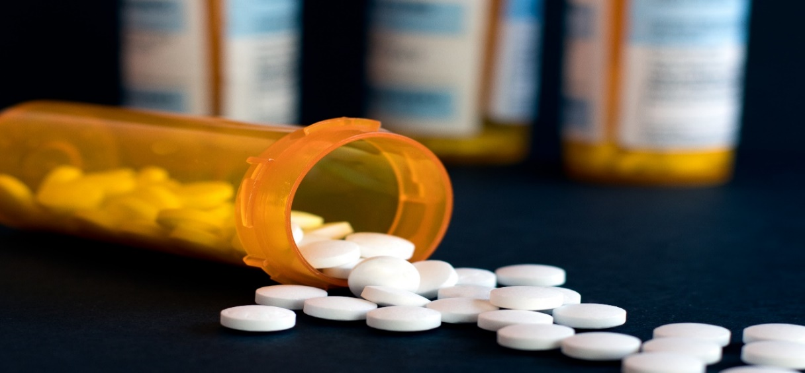
Drug Epidemics of the Decades
1970s
1980s–1990s
2010s
2000s
Notes:
Families and child welfare agencies have been affected by multiple drug epidemics over the past several decades—cocaine in the late 1980s, methamphetamine in the early 2000s, and now opioids.
Although drug epidemics may shift over time, the child welfare system continues to see families affected by substance use disorders.

Slide 7
Drug Classifications
Medications that increase alertness, attention, energy, blood pressure, heart rate, and breathing rate
Medications that slow brain activity, which makes them useful for treating anxiety and sleep problems
Short-term effects: Drowsiness, slurred speech, poor concentration, confusion, dizziness, problems with movement and memory, lowered blood pressure, slowed breathing.
Long-term effects: Unknown
Substances that distort the perception of reality
Short-term effects: increased heart rate, nausea, intensified feelings and sensory experiences, changes in sense of time
Short-term effects: Increased alertness, attention, energy; increased blood pressure and heart rate
Long-term effects: Heart problems, psychosis, anger, paranoia
Long-term effects: speech problems, memory loss, weight loss, anxiety, depression and suicidal thoughts
Stimulants
Central Nervous System Depressants
Hallucinogens
(National Institute on Drug Abuse, 2018a; National Institute on Drug Abuse, 2016)
Notes:
Stimulants
Examples of stimulants are dextroamphetamine (Dexedrine, Dextrostat, ProCentra), lisdexamfetamine (Vyvanse), methylphenidate (Concerta, Daytrana, Methylin, Ritalin), and the combination of amphetamine and dextroamphetamine (Adderall).
High doses: dangerously high body temperature and irregular heartbeat; heart disease; seizures.
Central Nervous System Depressants
Examples include alcohol, Valium, Xanax, Librium, and barbiturates
Hallucinogens
Examples of hallucinogens include ketamine, LSD, peyote, PCP, psilocybin, salvia, DMT, and ayahuasca.
Hallucinogens cause hallucinations. Their effects can last anywhere from 6 to 12 hours.

Slide 8
Common Drugs
A depressant, which means it slows the function of the central nervous system
A powerfully addictive stimulant drug made from the leaves of the coca plant native to South America
Short-term effects: Narrowed blood vessels, enlarged pupils, increased body temperature, heart rate, and blood pressure, headache, abdominal pain and nausea, euphoria
An opioid drug made from morphine, a natural substance extracted from the seed pod of various opium poppy plants
Short-term effects: Reduced inhibitions, slurred speech, motor impairment, confusion, memory problems, concentration problems
Long-term effects: development of an alcohol use disorder, health problems, increased risk for certain cancers
Long-term effects: Loss of sense of smell, nosebleeds, nasal damage and trouble swallowing from snorting, infection and death of bowel tissue from decreased blood flow
Short-term effects: Euphoria, dry mouth, itching, nausea, vomiting, analgesia, slowed breathing and heart rate
Long-term effect: Collapsed veins, abscesses (swollen tissue with pus), infection of the lining and valves in the heart, constipation and stomach cramps, liver or kidney disease, pneumonia
Alcohol
Cocaine
Heroin
(National Institute on Alcohol Abuse and Alcoholism; National Institute on Drug Abuse, 2018a)
Notes:
Review these common drugs and their short- and long-term effects.

Slide 9
Common Drugs (cont’d)
A stimulant drug chemically related to amphetamine but with stronger effects on the central nervous system
Made from the hemp plant, Cannabis sativa. The main psychoactive (mind-altering) chemical in marijuana is delta-9-tetrahydrocannabinol, or THC.
Pain relievers with an origin similar to that of heroin. Opioids can cause euphoria and are often used non-medically, leading to overdose deaths.
Short-term effects: Increased wakefulness and physical activity, decreased appetite, increased breathing, heart rate, blood pressure, temperature, irregular heartbeat
Short-term effects: Pain relief, drowsiness, nausea, constipation, euphoria, slowed breathing, death
Long-term effects: Anxiety, confusion, insomnia, mood problems, violent behavior, paranoia, hallucinations, delusions, weight loss
Short-term effects: Enhanced sensory perception and euphoria followed by drowsiness/relaxation; slowed reaction time; problems with balance and coordination
Long-term effects: Mental health problems, chronic cough, frequent respiratory infections
Long-term effects: Increased risk of overdose or addiction if misused
Methamphetamine
Marijuana
Opioids
(National Institute on Drug Abuse, 2018a)
Notes:
Review these common drugs and their short- and long-term effects.
Methamphetamine
Street names for the drug include "speed," "meth," and "crank."
Methamphetamine is used in pill form or in powdered form by snorting or injecting. Crystallized methamphetamine known as "ice," "crystal," or "glass," is a smokable and more powerful form of the drug.
Marijuana
Marijuana is the most widely used illicit drug in the United States and tends to be the first illegal drug teens use. It can be either smoked or swallowed.

Slide 10
The Brain Science of Addiction

Slide 11
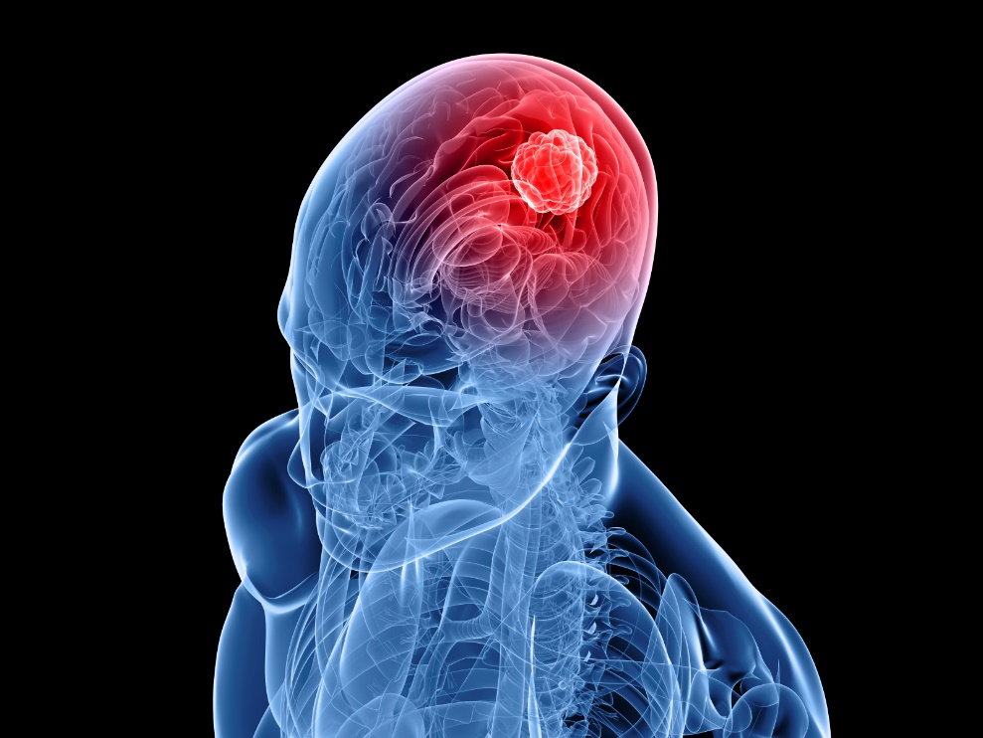
American Society of Addiction Medicine (ASAM)
“Addiction is a primary, chronic disease of brain reward, motivation, memory and related circuitry. Dysfunction in these circuits leads to characteristic biological, psychological, social, and spiritual manifestations. This is reflected in an individual pathologically pursuing reward and/or relief by substance use and other behaviors.”
(American Society of Addiction Medicine, 2011)
Notes:
Addiction is a chronic disease of the brain, not a moral failing or lack of willpower. Discuss how our understanding of addiction has changed over time thanks to scientific advancements.
American Society of Addiction Medicine (ASAM) Public Policy Statement: Short Definition of Addiction
Addiction is a primary, chronic disease of brain reward, motivation, memory, and related circuitry. Dysfunction in these circuits leads to characteristic biological, psychological, social, and spiritual manifestations. This is reflected in an individual pathologically pursuing reward and/or relief by substance use and other behaviors.
Addiction is characterized by inability to consistently abstain, impairment in behavioral control, craving, diminished recognition of significant problems with one’s behaviors and interpersonal relationships, and a dysfunctional emotional response. Like other chronic diseases, addiction often involves cycles of relapse and remission. Without treatment or engagement in recovery activities, addiction is progressive and can result in disability or premature death.

Slide 12
Drug Use and Addiction
Brain imaging studies show physical changes in areas of the brain when a drug is ingested that are critical to:
Judgment
Decision making
Learning and memory
Behavior control
These changes alter the way the brain works and help explain the compulsion and continued use despite negative consequences
(National Institute on Drug Abuse, 2018b)
Notes:
Addiction is a chronic, relapsing brain disease that involves changes to the reward circuit of the brain and affects judgment, decision making, learning, and memory and behavior control. These changes in the brain persist even after substance use has stopped.
Next, we will see a video that will shows the changes that happen in the brain.

Slide 13
The Rise and Fall of the Cocaine High
Notes:
View this hyperlinked video on how the brain responds to cocaine and discuss the changes that occur in the brain.

Slide 14
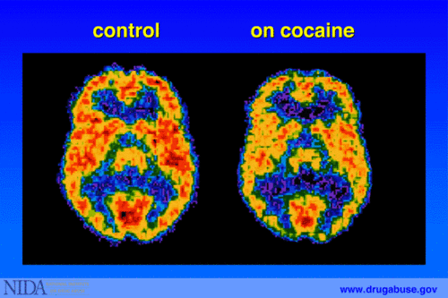
Effects of Cocaine on the Brain
(National Institute on Drug Abuse, 2007)
Notes:
The PET scan allows us to see how the brain uses glucose. Glucose provides energy to each neuron so that it can perform work. The scans show where the cocaine interferes with the brain's use of glucose—or its metabolic activity. The left scan is taken from a person who is not using cocaine. The red color shows the highest level of glucose utilization (yellow represents less utilization and blue shows the least). The right scan is taken from a person using cocaine. It shows that the brain cannot use glucose nearly as effectively. Note that there is less red than in the scan on the left, indicating less glucose utilization. There are many areas of the brain that have reduced metabolic activity. The continued reduction in the neurons' ability to use glucose (energy) results in disruption of many brain functions.
Key takeaway: There are changes in brain activity caused by substance use disorders that have an effect on a person’s judgment, decision making, behavior, and memory and learning.

Slide 15
Dopamine and Substance Use
Dopamine:
A neurotransmitter that is released during a pleasurable experience
Connected to the reward circuit of the brain
Acts by reinforcing behaviors that are pleasurable
Leads to neural changes that help form habits
Released during substance use and reinforces the connection between the substance and the pleasurable experience
Trains the brain to repeat the pleasurable experience
(National Institute on Drug Abuse, 2018b)
Notes:
Dopamine is a neurotransmitter that is released during a pleasurable experience to increase the likelihood of the experience being repeated. Substance use leads to the release of endorphins and other neurotransmitters, including dopamine, associated with the reward circuit in the brain. The continued release of dopamine associated with a pleasurable experience leads to changes in the brain that make it easier for the activity to be repeated. Over time, the brain starts to seek this experience. Activities associated with the pleasurable experience can trigger cravings even after substance use is stopped.

Slide 16
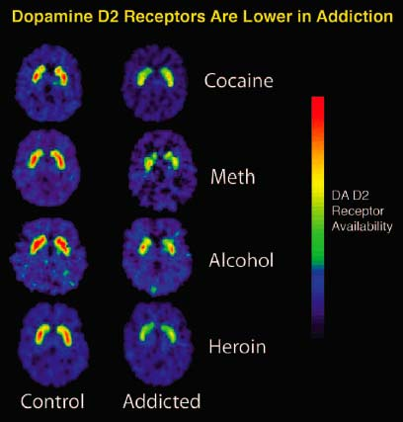
Dopamine Receptors in Addiction
(Davis, 2007)
Notes:
By altering neurotransmission, drugs can produce effects that make people want to use them repeatedly and induce health problems that can be long lasting.
The PET images show that repeated exposure to specific drugs depletes the brain's dopamine receptors, which are critical for one's ability to experience pleasure and reward.
These changes in the brain make it harder for people to stop using drugs.

Slide 17
Effects of Meth on the Brain
Healthy Person
Meth Use Disorder
1 month abstinence
Meth Use Disorder
14 months abstinence
(National Institute on Drug Abuse, 2013)
(National Institute on Drug Abuse, 2013)
Notes:
Although a substance use disorder is a chronic, relapsing brain disease, there is hope. These images show the brain’s remarkable potential to recover, at least partially, after a long abstinence from drugs—in this case, methamphetamine.
You can see the image on the left of a person who is not using substances and compare the similarities after a period of abstinence from methamphetamine.

Slide 18
Discussion
Think about the parenting implications for a parent involved in child welfare who is actively using drugs or alcohol.
Think about the implications for a parent involved in child welfare who has just stopped using drugs or alcohol and is trying to resume normal interactions with their child/ren.
If you are tasked with observing a home visit, what conclusions might you draw?
How do we balance compassion, understanding and patience with a parent’s temporarily compromised brain condition, while maintaining parent accountability and child safety?
Notes:
When someone is using substances, their thinking and behavior are altered by the substance use. When someone stops use, it takes some time for the brain chemistry to begin to return to normal.
***Ask the group the question. If a parent was using a substance or recently stopped using substances, what might you see when on a home visit? Make a list as a group.

Slide 19
The Effect of Parental
Substance Use on Families

Slide 20
In-Home Indicators of Potential Parental Substance Use
A report of substance use in the child protective services call or report
Paraphernalia observed or reported in the home
The smell of alcohol, marijuana, or other drugs on the parent or in the home
A child reports use by parent(s) or adults in the home
Parent’s behavior suggests intoxication
Parent exhibits signs of a substance use disorder
Parent reports their own substance use
Parent shows or reports experiencing physical effects of a substance use disorder and/or withdrawal
Note: This list is not meant to include all possible signs.
(Breshears, 2009)
Notes:
The next session of this training discusses possible use or substance use disorder indicators that you need to look for when you conduct a home or on-site visit or investigation:
A report of substance use in the child protective services call or report.
Observations or reports of paraphernalia in the home.
This can include things such as a syringe kit, pipes, a charred spoon, foils, a large number of liquor or beer bottles, etc.
The parent (or the home) smells of alcohol, marijuana, or other drugs (drugs can produce different smells).
A child reports use by parent(s) or other adults in the home.
A parent exhibits physical behavior that suggests that they are under the influence of alcohol or drugs.
This might include slurred speech, an inability to mentally focus, poor physical balance, or extreme lethargy or hyperactivity.
A parent shows signs of a substance use disorder.
Examples include needle tracks, skin abscesses, burns on inside of lips, etc.
A parent reports their own substance use.
A parent shows or reports experiencing physical effects of a substance use disorder, including withdrawal.
Signs of withdrawal include nausea, euphoria, slowed thinking, and hallucinations.
***This list is not meant to be inclusive of all possible signs. Ask participants if they can identify other signs of use.

Slide 21
Effects of Substance Use Disorders on Family Functioning
Child development
Household safety
Psychosocial impact
Parenting skills
Intergenerational trauma and mental health problems
(Smith & Wilson, 2016)
Notes:
The life of a person with a substance use disorder is often out of balance, and the negative effects of use and misuse can have an enormous impact on his or her family and friends. The following shows how substance use disorders negatively affect a family’s functioning across several domains.
Child Development
Children may present with fetal alcohol syndrome or have a history of neonatal abstinence syndrome. Infants exposed to substances may experience a range of social, emotional, and behavioral effects as a result of exposure.
Household Safety
Parents may neglect a child’s basic needs (e.g., empty cupboards, no adult supervision). Parental use may include manufacturing substances or selling drugs. Children may be exposed to harsh chemicals (i.e., those used in methamphetamine labs) or to dangerous and traumatic situations.
Psychosocial Impact
Children may struggle with communication difficulties, overstimulation, or emotional regulation. The postnatal environment may contribute to insecure attachment or other social-emotional concerns.
Parenting
Parent-child relationships may lack trust. Children may feel as though they must be the parent, resulting in feelings of anxiety and stress.
Parents may lack the skills to parent effectively, due to their own history as children of substance users.
Parent may use harsh discipline.
Intergenerational
Multiple generations of the family may be affected by substance use disorders.
Parents may lack basic family support, due to generational substance use disorders.
The family may present with issues of chronic neglect, due to the effects of long-term substance use disorders.

Slide 22
The Risks of Parental Substance Use Disorders on Children: Alcohol and Illegal Drugs
Alcohol
Lowers inhibitions, impairs judgment and motor skills
Parents may have rage or depressive episodes which compromise parenting abilities
Cocaine
Causes increased irritability and aggression with prolonged use, psychotic distortions of thought
A child’s cry to a parent may trigger angry and/or excessive reactions
Crack Cocaine
Heroin
Causes 5-15 minute high, followed by anxiety, depression, paranoia, and intense craving
Injecting, snorting, or smoking heroin causes initial euphoria, followed by an alternately wakeful and drowsy state
Some parents will do whatever it takes to pursue their habit, even if it means sacrificing the health and well-being of loved ones
Children may be left unsupervised by parents who “nod out” while under the influence of heroin
(Breshears, 2009; National Institute on Drug Abuse, 2018a)
Notes:
Let’s discuss alcohol and other drug types and the potential effect the use of the drugs may have on a parent’s behavior or mood. It is important to note that these are just some examples and that individuals may have different reactions. Also, many people are polysubstance users, using multiple substances.
Alcohol
Risks to children:
Children’s needs may be neglected by a parent who forgets or fails to attend to parenting responsibilities.
Children may be left alone all night due to a parent’s intoxication.
A parent may have rages and depressive episodes, creating an unstable environment for children.
Cocaine
In addition to an influx of energy, cocaine also heightens the senses. Colors appear brighter, smells seem stronger, and noises sound louder.
Risks to children:
A parent may become angry or impatient with a child for any reason because of thought distortion and misperception of the child’s intent.
Crack cocaine
Crack heightens feelings of power and control over one’s life, feelings that may be sorely lacking in those belonging to oppressed social groups.
Risks to children:
Infants or toddlers may be left alone for hours or sometimes days at a time as parents pursue the drug.
Children may be living in homes barren of furniture and appliances that have been sold to purchase crack and other drugs.
The absence of food in the refrigerator or cupboards is evidence of parental inability to attend to a child’s most basic needs.
Some parents will do whatever it takes to pursue their habit, even if it means sacrificing the health and well-being of loved ones.
Crack can contribute to a significant increase in sexual abuse of young children in two ways: The heightened physical sensations induced by crack can lead users to seek out sexual encounters. A child who is available and unprotected by a functioning adult, as when children accompany parents to so-called crack houses, is an easy target for sexual abuse by an individual high on crack.
Very young children, even babies, can be prostituted by their parents desperate to obtain the drug.
Heroin
Heroin is a highly addictive drug leading to serious, even fatal health conditions.
Tolerance to the drug develops with regular use, meaning that the user must use more heroin to produce the same effect.
Physical dependence and addiction then develop, and withdrawal can occur as soon as a few hours after the last use.
Risks to children:
Children’s needs may be neglected by a parent who may forget or fail to attend to parenting responsibilities.
Children may be left alone while parents look for, obtain, or use the drug.
Children may be exposed to unsafe and dangerous situations, such as heroin dealers and other users.

Slide 23
The Risks of Parental Substance Use Disorders on Children: Alcohol and Illegal Drugs
Methamphetamine
Releases high levels of dopamine, which stimulates brain cells, enhancing mood and body movement
Children may be the victims of parental violence, aggression, and paranoia due to parental meth use
Marijuana
Slows down the nervous system function, producing a drowsy or calming effect
Children may be left unsupervised, as parents may fall asleep while under the influence of marijuana.
(Breshears, 2009; National Institute on Drug Abuse, 2018a)
Notes:
Methamphetamine
Smoking or injecting methamphetamine causes a euphoria that is notable for its intensity and length.
Snorting or ingesting methamphetamine produces a milder and less intense euphoria.
Following the initial euphoria, the user “crashes” into an irritable, anxious, paranoid, aggressive, or empty feeling. During this cycle, the user may have a sleep episode, or the user may continue to use methamphetamine to regain the euphoric state.
Severe withdrawal symptoms may include psychotic episodes and extreme violence.
Methamphetamine use can quickly lead to addiction and is linked to long-term brain damage, as well as cardiovascular and other major health problems.
Risks to children:
Children may lack basic nutrition, hygiene, or medical care due to parental use.
Children may also be neglected during sleep episodes after the initial euphoria of the drug has worn off.
Additional risks to children can be quite extreme if the drug is being “cooked” in their residence. These risks include fire and explosions, as well as unintentional absorption of the drug from the home environment.
Marijuana
Risks to children:
Children may lack basic nutrition, hygiene, and medical care due to the parent forgetting or failing to attend to parenting responsibilities.
Children may be left alone while parents look for, obtain, or use the drug.

Slide 24
The Risks of Parental Substance Use Disorders on Children: Prescription Drugs and Pain Medications
Prescription Opioids
Opioids block the transmission of pain messages to the brain and produce euphoria followed by drowsiness
Children may be left unsupervised by parents who “nod out” while under the influence
These drugs are stimulants to the central nervous system, which increase alertness, attention, and energy.
A stimulant user may feel energetic with very little sleep
Because their own sleep-wake cycles are so distorted by the drug, parents on amphetamines may be unable to attend to a child’s need for structure and pattern.
Stimulants
(Breshears, 2009; National Institute on Drug Abuse, 2018a)
Notes:
Prescription Opioids
Chronic use can result in tolerance, dependence, and withdrawal.
Examples include codeine, fentanyl, hydrocodone, morphine, and oxycodone.
Methadone, buprenorphine, and naltrexone are synthetic opioids used to treat a heroin substance use disorder.
Risk to children:
Children may lack basic nutrition, hygiene, and medical care because the parent forgets or neglects to attend to parenting responsibilities.
Children may be left alone while parents look for, obtain, or use the drug.
Stimulants
Amphetamines and methylphenidate (prescription drugs).
Risk to children:
The parent may become impatient or irritated with the child, who is unable to adapt to the parent’s level of energy.
When a parent is not hungry due to the appetite-suppressive effects of stimulants, and therefore is not preparing meals for themselves, they may also fail to consider a child’s hunger and may not ensure that he\she is fed on a regular basis.

Slide 25
Parental substance use affects the whole family
Developmental effect
Psycho-social effects
Effect on parenting
Generational effects
Notes:
This slide summarizes the ways that parental substance use can affect the family.
***Review highlights from the previous slides and ask participants if they have any other examples of effects of parental substance use on the family.

Slide 26
Screening for Substance Use Disorders

Slide 27
Screening: The Role of Child Welfare Workers
Screening
Signs and symptoms of parental substance use disorders during initial screening or assessment for child abuse and neglect
Signs and symptoms of parental substance use disorders throughout the child welfare case
Referral
Refer parent to a substance use disorder treatment provider for further assessment
The substance use disorder treatment provider may refer the parent to a treatment program
(Breshears, 2009)
Notes:
What is the role of child welfare workers in screening for a concern of a parental substance use disorder?
When a report of child abuse or neglect has to be investigated, emergency response workers or investigators are generally the first ones to see the parents.
This is a time to conduct the initial screening of parents for potential substance use disorder. They may observe overt signs and symptoms as part of the initial screening and assessment for child abuse and neglect. Screening may be done with a validated substance use disorder screening tool, screening questions, and\or through observation of home and of the parent.
Sometimes, concerns around parental substance use disorder become more apparent after the initial investigation or assessment. Child welfare assessment of families is a process, not an event. If additional concerns arise, further screening may be necessary.
Once concerns of a potential substance use disorder are identified through a child welfare screening or assessment process, a referral to a substance use disorder treatment provider for a clinical assessment is the next step. A substance use disorder treatment provider will complete an assessment and determine the need for substance use disorder treatment.

Slide 28
The Purpose of Screening
Determine the risk or probability that a parent has a substance use disorder
Screen everyone
Use observation, interviews, and standardized screening tools
Refer for an assessment by a substance use disorder treatment provider if needed
(Roberts & Nuru-Jeter, 2012)
Notes:
Who needs to be screened?
It is recommended that child welfare workers screen everyone to identify those who may be at risk and rule out those who appear not to be at risk.
Screening is a combination of observation, interviews, and the use of a standardized set of questions, such as those that are included in many effective evidence-based screening tools.
The purpose of a substance use related screening is to determine the need for assessment—that is, determine the risk or probability that a parent has a substance use disorder, and whether more in-depth clinical assessment by treatment professionals is needed.
***Talk about your agency’s screening process and referral to substance use disorder treatment.
For further information on engagement strategies, please see Module 4: Engagement and Intervention with Parents Affected by Substance Use Disorders and Mental Health/Trauma.

Slide 29
Substance Use Disorder Treatment

Slide 30
A Treatable Disease
Substance use disorders are preventable and treatable
Successful substance use disorder treatment is highly individualized and entails:
Medication
Behavioral interventions
Peer support
"Groundbreaking discoveries about the brain have revolutionized our understanding of addiction, enabling us to respond effectively to the problem"
- Dr. Nora Volkow, National Institute on Drug Abuse
(National Institute on Drug Abuse, 2018c; Longo, 2016)
Notes:
Discoveries in the science of addiction have led to advances in substance use disorder treatment that help people stop misusing drugs and resume productive lives. Treatment enables people to counteract addiction's powerful disruptive effects on the brain circuitry and behavior and regain areas of life function.

Slide 31
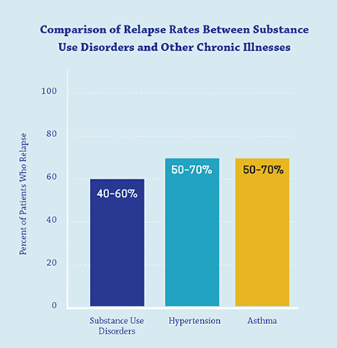
Relapse Rates for Chronic Conditions
(McLellan et al., 2000)
Notes:
The chronic nature of the disease means that relapsing is not only possible, but likely. Relapse rates (i.e., how often symptoms occur) for substance use disorder are similar to those for other well-characterized chronic medical illnesses such as diabetes, hypertension, and asthma, which also have both physiological and behavioral components.

Slide 32
Purpose of Treatment
Reduce the major symptoms of the illness
Improve health and social functioning
Teach and motivate individuals to monitor their condition and manage threats of relapse
(National Institute on Drug Abuse, 2018c)
Notes:
Research indicates that most individuals with substance use disorders need at least three months in treatment to significantly reduce or stop their drug use and that the best outcomes occur with longer durations of treatment.
According to research that tracks individuals in treatment over extended periods, most people who enter and remain in treatment stop using drugs, decrease their criminal activity, and improve their occupational, social, and psychological functioning.
Treatment enables people to counteract a substance use disorder’s powerful disruptive effects on the brain and behavior and to regain control of their lives. Treatment also helps individuals understand relapse triggers and how to plan for relapse.

Slide 33
Diagnosing Substance Use Disorders:
DSM-5 Criteria
Impaired Control
Larger amounts or over a longer time than originally intended
Persistent desire to cut down
A great deal of time spent obtaining the substance
Intense craving
2. Social Impairment
Failure to fulfill work or school obligations
Recurrent social or interpersonal problems
Withdraw from social or recreational activities
3. Risky Use
Recurrent use in situations physically hazardous
Continued use despite persistent physical or psychological problem that is likely to have been caused or exacerbated by use
4. Pharmacological Criteria
Tolerance: Need for markedly increased dose to achieve the desired effect
Withdrawal: Syndrome that occurs when blood or tissue concentrations of a substance decline in an individual who had maintained prolonged heavy use
Severe
6+ Criteria
Moderate
4-5 Criteria
Mild
2-3 Criteria
(American Psychiatric Association, 2013)
Notes:
What do we mean by a substance use disorder?
Substance use disorders are a problematic pattern of substance use leading to clinically significant impairment or distress, as manifested by at least two of the above criteria, and occurring at any time in the same 12-month period.
This slide summarizes the criteria now used to diagnose a substance use disorder. It represents a departure from previous editions of the DSM. Previously, diagnosis was based on categories of use, dependence and addiction. New criteria uses Mild, Moderate and Severe based on the presence and number of symptoms.
Generally speaking, substance use disorder assessment tools draw from the criteria in the American Psychiatric Association’s Diagnostic and Statistical Manual of Mental Disorders, Fifth Edition (DSM-5), which is the standard for classifying mental disorders in the United States.
***Highlight that only a licensed counselor is able to diagnosis a person with a substance use disorder.

Slide 34
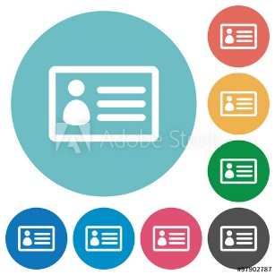
Overview of the Treatment Process
Early Identification, Screening,
and Brief Intervention
Done at earliest point possible
Determine extent and severity of disease
Comprehensive
Assessment
Stabilization
Via medically supervised detoxification, when necessary
Timely and Appropriate Substance Use Disorder Treatment
Address substance use disorder and co-occurring issues
Help parents sustain recovery, maintain family safety and stability
Continuing Care and Recovery Support
(American Society of Addiction Medicine, 2014)
Notes:
When child welfare workers have concern that a parent may have a substance use disorder, they will need to refer the parent to substance use disorder treatment. This slide provides a general overview of the treatment process from assessment through ongoing support.

Slide 35
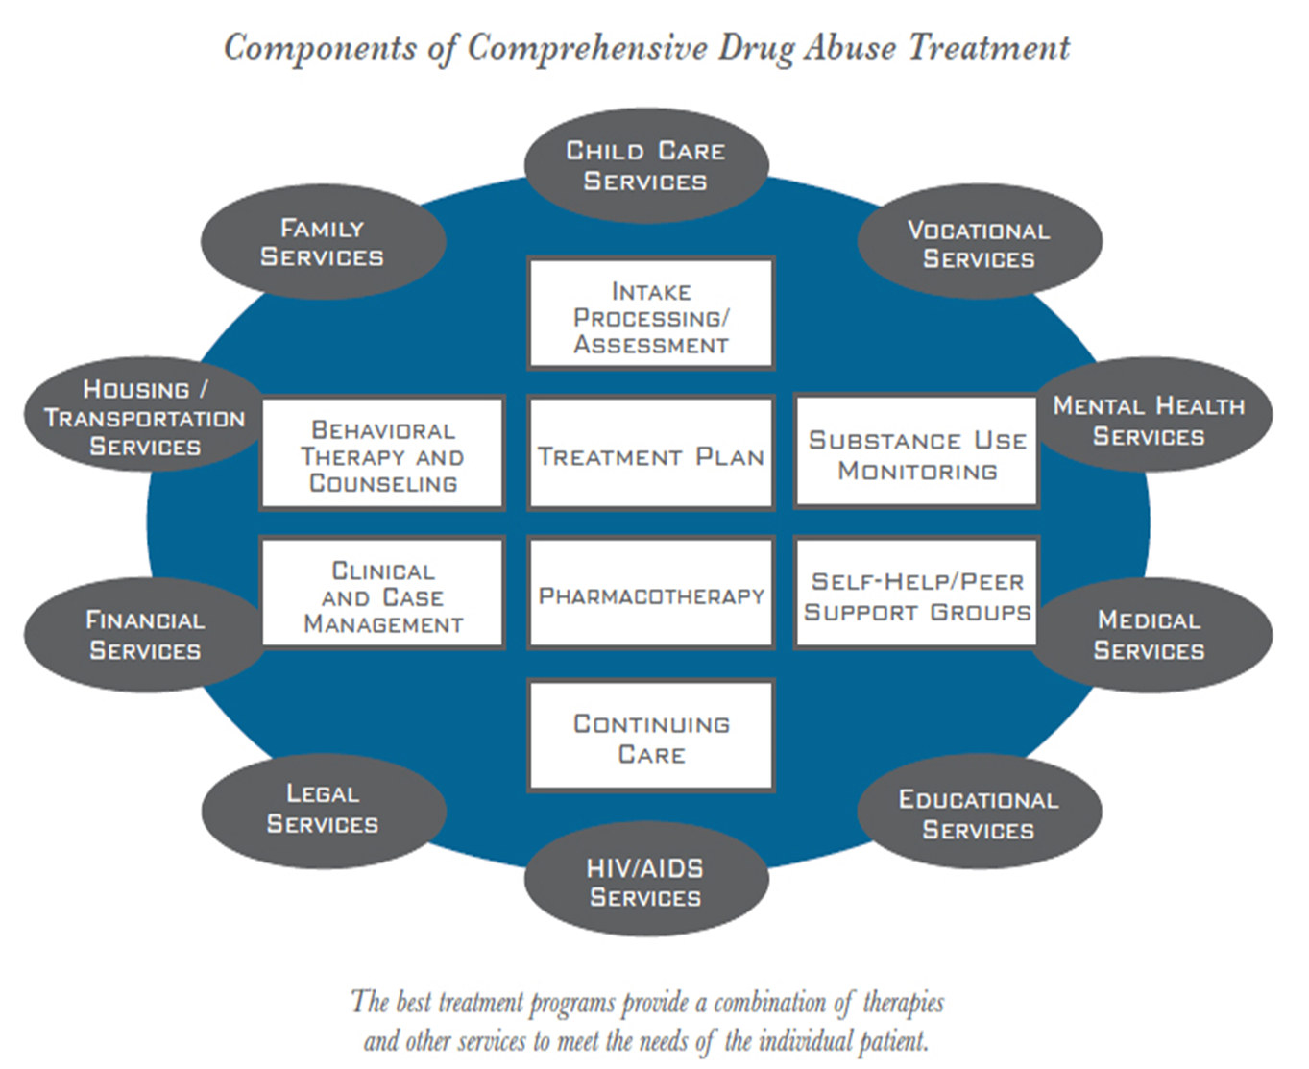
Full Spectrum of Treatment and Services
(National Institute on Drug Abuse, 2018c)
Notes:
The best treatment programs provide a combination of therapies and other services to meet the needs of the individual patient.
Comprehensive treatment is not available in all communities.
***Highlight your local treatment providers and the services they offer. Provide a resource list of local services to participants.

Slide 36
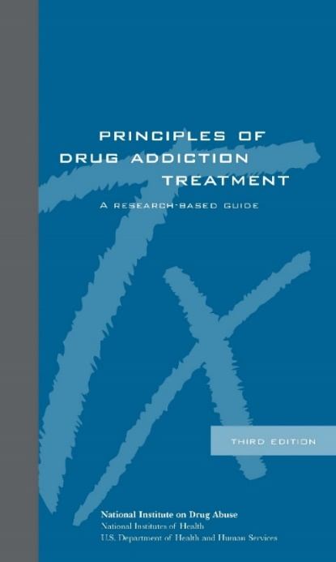
Principles of Effective Drug Addiction Treatment: A Research Based Guide
Addiction is a complex but treatable disease that affects brain function and behavior
No single treatment is appropriate for everyone
Treatment needs to be readily available
Effective treatment attends to multiple needs of the individual, not just his or her drug abuse
Remaining in treatment for an adequate period of time is critical
Behavioral therapies are the most commonly used forms of drug abuse treatment
Medications are an important element of treatment for many patients, especially when combined with counseling and other behavioral therapies
(National Institute on Drug Abuse, 2018c)
Notes:
Because there are so many dimensions to substance use disorders and treatment, the National Institute on Drug Abuse (NIDA) has developed Principles of Effective Drug Addiction Treatment that speak to the many different facets of substance use disorder treatment. Effective treatment programs typically incorporate many components, each directed to a particular aspect of the illness and its consequences. Substance use disorder treatment must help the individual stop using drugs, maintain a drug-free lifestyle, and achieve productive functioning in the family, at work, and in society. Because a substance use disorder is a disease, most people cannot simply stop using drugs for a few days and be cured. Patients typically require long-term or repeated episodes of care to achieve the ultimate goal of sustained abstinence and recovery of their lives. Indeed, scientific research and clinical practice demonstrate the value of continuing care in treating addiction, with a variety of approaches having been tested and integrated in residential and community settings.
Addiction is a complex but treatable disease that affects brain function and behavior. Drugs of abuse alter the brain’s structure and function, resulting in changes that persist long after drug use has ceased. This may explain why there is a risk for relapse even after long periods of abstinence and despite the potentially devastating consequences.
No single treatment is appropriate for everyone. Treatment varies depending on the type of drug and the characteristics of the patients. Matching treatment settings, interventions, and services to an individual’s particular problems and needs is critical to his or her ultimate success in returning to productive functioning in the family, workplace, and society.
Treatment needs to be readily available. Because individuals may be uncertain about entering treatment, taking advantage of available services the moment people are ready for treatment is critical. Potential patients can be lost if treatment is not immediately available or readily accessible. As with other chronic diseases, the earlier treatment is offered in the disease process, the greater the likelihood of positive outcomes.
Effective treatment attends to multiple needs of the individual, not just his or her drug abuse. To be effective, treatment must address the individual’s substance use disorder and any associated medical, psychological, social, vocational, and legal problems. It is also important that treatment be appropriate to the individual’s age, gender, ethnicity, and culture.
Remaining in treatment for an adequate period of time is critical. The appropriate duration for an individual depends on the type and degree of the patient’s substance use disorder and needs. Research indicates that most individuals need at least 3 months in treatment to significantly reduce or stop their drug use and that the best outcomes occur with longer durations of treatment. Recovery from a substance use disorder is a long-term process and frequently requires multiple episodes of treatment. As with other chronic illnesses, relapses can occur and should signal a need for treatment to be reinstated or adjusted. Because individuals often leave treatment prematurely, programs should include strategies to engage and keep patients in treatment.
Behavioral therapies—including individual, family, or group counseling—are the most commonly used forms of treatment. Behavioral therapies vary in their focus and may involve addressing a patient’s motivation to change, providing incentives for abstinence, building skills to resist drug use, replacing drug-using activities with constructive and rewarding activities, improving problem-solving skills, and facilitating better interpersonal relationships. Also, participation in group therapy and other peer support programs during and following treatment can help maintain abstinence.
Medications are an important element of treatment for many patients, especially when combined with counseling and other behavioral therapies. For example, methadone, buprenorphine, and naltrexone are effective in helping individuals using heroin or other opioids stabilize their lives and reduce their illicit drug use. Acamprosate, disulfiram, and naltrexone are medications approved for treating alcohol dependence.

Slide 37
Principles of Effective Drug Addiction Treatment: A Research Based Guide (cont’d)
An individual’s treatment and services plan must be assessed continually and modified as necessary to ensure that it meets his or her changing needs
Many drug-addicted individuals also have other mental disorders
Medically assisted detoxification is only the first stage of addiction treatment and by itself does little to change long-term drug abuse
Treatment does not need to be voluntary to be effective
Drug use during treatment must be monitored continuously, as lapses during treatment do occur
Treatment programs should test patients for infectious diseases
(National Institute on Drug Abuse, 2018c)
Notes:
An individual's treatment and services plan must be assessed continually and modified as necessary to ensure that it meets his or her changing needs. A patient may require varying combinations of services and treatment components during the course of treatment and recovery. In addition to counseling or psychotherapy, a patient may require medication, medical services, family therapy, parenting instruction, vocational rehabilitation, and/or social and legal services. For many patients, a continuing care approach provides the best results, with the treatment intensity varying according to a person’s changing needs.
Many individuals also have other mental disorders. Because substance use disorders often co-occur with other mental disorders, patients presenting with one condition should be assessed for the other(s). And when these problems co-occur, treatment should address both (or all), including the use of medications as appropriate.
Medically assisted detoxification is only the first stage of addiction treatment and by itself does little to change long-term drug abuse. Although medically assisted detoxification can safely manage the acute physical symptoms of withdrawal and can, for some, pave the way for effective long-term addiction treatment, detoxification alone is rarely sufficient to help addicted individuals achieve long-term abstinence. Thus, patients should be encouraged to continue substance use disorders treatment following detoxification. Motivational enhancement and incentive strategies, begun at initial patient intake, can improve treatment engagement.
Treatment does not need to be voluntary to be effective. Sanctions or enticements from family, employment settings, and/or the criminal justice system can significantly increase treatment entry, retention rates, and the ultimate success of substance use disorder treatment interventions.
Drug use during treatment must be monitored continuously, as lapses during treatment do occur. Knowing their drug use is being monitored can be a powerful incentive for patients and can help them withstand urges to use drugs. Monitoring also provides an early indication of a return to drug use, signaling a possible need to adjust an individual’s treatment plan to better meet his or her needs.
Treatment programs should test patients for the presence of HIV/AIDS, hepatitis B and C, tuberculosis, and other infectious diseases, as well as provide targeted risk-reduction counseling, linking patients to treatment if necessary. Typically, substance use disorder treatment addresses some of the behaviors that put people at risk of infectious diseases. Targeted counseling focused on reducing infectious disease risk can help patients further reduce or avoid substance-related and other high-risk behaviors. Counseling can also help those who are already infected to manage their illness. Moreover, engaging in substance use disorder treatment can facilitate adherence to other medical treatments. Substance use disorder treatment facilities should provide onsite, rapid HIV testing rather than referrals to offsite testing—research shows that doing so increases the likelihood that patients will be tested and receive their test results. Treatment providers should also inform patients that highly active antiretroviral therapy (HAART) has proven effective in combating HIV, including among substance use disorder populations, and help link them to HIV treatment if they test positive.

Slide 38
Services That Parents in Treatment May Need
Access to physical necessities
Medical care
Psychological assessment, and mental health and trauma treatment
Parenting and child development education
Child care
Social services, social support
Family therapy and health education
Family planning services
(Werner et al., 2007; Substance Abuse and Mental Health Services Administration, 2009)
Notes:
Treatment for substance use disorders should be individualized. However, there are services that most parents with substance use disorders in the child welfare system will need at various points in the treatment process. Child welfare workers may work with treatment providers to ensure that parents in treatment have access to these critical services.

Slide 39
Services That Parents in Treatment May Need
Life skills training
Language and literacy training
Continuing aftercare programming
Support in sustaining visitation with children
Case management
(Werner et al., 2007; Substance Abuse and Mental Health Services Administration, 2009)
Notes:
Review the areas of additional services that a parent in substance use disorder treatment may need in addition to substance use disorder treatment programs. Some programs, such as residential programs, offer these additional services as part of their program.

Slide 40
Contact With Children
Parents in treatment may—or may not—see their children
Visitation is important to children and parents
Interventions to treat substance use disorders, child neglect, and maltreatment are more effective if family centered
Prepare children for visits with a parent in in-patient treatment
(Zweben, 2015; Wells, 2015; Munoz, 2014; Roggman & Cardia, 2016)
Notes:
While parents are in treatment, they may or may not have contact with their children. This often depends on the guidelines of the treatment program. Family Residential Treatment programs provide an opportunity for parents to live with their children in a treatment environment and often receive services together.
In cases where the court has jurisdiction, court orders may or may not allow visitation, or they may put restrictions on supervision, frequency, or duration of visits. Visitation is important to both the children and the parents. Visitation is important for overall well-being, attachment, and bonding between a child and a parent.
The child welfare worker must prepare the children, in developmentally appropriate ways, for a visit with a parent who is in in-patient treatment and take into account the possible effects on both the parent and the child. Children may not understand why a parent is in treatment or why they are not able to live with their parent.

Slide 41
Family-Centered Approach
Recognizes that addiction is a brain disease that affects the entire family and that recovery and well-being occurs in the context of the family
(Adams, 2016; Bruns, 2012)
Notes:
When child welfare workers and substance use treatment providers working with families with substance use disorders recognize that substance use disorders are a brain disease rather than a personal failing or chosen behavior, it can help to reduce stigma.
Reducing stigma ensures that clients are seen as whole people. Child welfare workers and substance use treatment providers can identify client strengths and recognize opportunities to improve parenting and support the parent-child relationship so that families can stay together safely.
Viewing the family as a system requires a shift in thinking for child welfare workers who have traditionally focused on their mission of safety and well-being of the child, and substance use treatment providers, who traditionally have focused on treatment and recovery of the parent. Child safety and parental recovery are critically linked to one another and must be addressed holistically to ensure the best outcomes for the entire family.

Slide 42
Continuum of Family-Based Services
Parent’s Treatment With Family
Involvement
Parent’s Treatment with Children Present
Parent’s and Children’s Services
Family Services
Family-Centered Treatment
Services for parent(s) with substance use disorders. Treatment plan includes family issues, family involvement
Children accompany parent(s) to treatment. Children participate in child care, but receive no therapeutic services. Only parent(s) have treatment plans
Children accompany parent(s) to treatment. Parent(s) and attending children have treatment plans and receive appropriate services
Children accompany parent(s) to treatment; parent(s) and children have treatment plans. Some services provided to other family members
Each family member has a treatment plan and receives individual and family services
Goal: improved outcomes for parent(s)
Goal: improved outcomes for parent(s)
Goals: improved outcomes for parent(s) and children, better parenting
Goals: improved outcomes for parent(s) and children, better parenting
Goals: improved outcomes for parent(s), children, and other family members; better parenting and family functioning
(Werner et al., 2007; Substance Abuse and Mental Health Services Administration, 2009)
Notes:
Family-centered treatment addresses the effects of substance use disorders on every family member. This treatment approach focuses on the needs and welfare of children within the context of their families and communities. Family-centered practice recognizes the strengths of family relationships and builds on these strengths to achieve optimal outcomes.
This slide displays the continuum of family-based services, which offers a framework for defining the approaches to family involvement in treatment services.
At a minimum, family-based services acknowledge the influence and importance of family, provide for family involvement, and address family issues in individual treatment plans.
The most comprehensive model of family-based services is the family-centered treatment model, in which each family member has an individual treatment plan and receives individual and family services.

Slide 43
Principles of Family-Centered Treatment
Treatment is comprehensive and inclusive of substance use disorder, clinical support services, and community supports for parents and their families
The parent or caregiver defines “family” and treatment identifies and responds to the effect of substance use disorders on every family member
Families are dynamic, and thus treatment must be dynamic
Conflict within families is resolvable, and treatment builds on family strengths to improve management, well-being, and functioning
(Werner et al., 2007)
Notes:
Currently, there is no universally accepted definition of “family-centered treatment.” Provider approaches may differ along a continuum, from family involvement (a minimum standard of service) to family-centered services (in which children or other family members may receive their own services) to full comprehensive family-based treatment (in which all members of the family have individualized case plans and share an integrated family plan).
Despite this variation, some common principles underlie family-centered treatment, including:
It is comprehensive and includes clinical treatment for substance use disorders, clinical support services, and community supports for parents and their families. Services often include recovery coaches or mentors, case management, aftercare services, access to co-occurring services, or other identified needs for the parent and the family.
It focuses on the entire family unit as opposed to the individual parent with a substance use disorder. Parents or caregivers define their families and treatment identifies and responds to the impact of substance use disorders on every family member.
Treatment is based on the unique needs and resources of individual families.
Families are dynamic, and thus treatment must be dynamic.
Conflict within families is inevitable, but resolvable. Treatment offers whole family services that build on family members’ strengths to improve family management, well-being, and functioning.

Slide 44
Principles of Family-Centered Treatment (cont’d)
Cross-system coordination is necessary to meet complex family needs
Services must be gender responsive and specific and culturally competent
Family-centered treatment requires an array of professionals and an environment of mutual respect and shared training
Safety of all family members comes first
Treatment must support creation of healthy family systems
(Werner et al., 2007)
Notes:
Meeting complex family needs requires coordination across systems.
Services must be gender responsive and specific and culturally competent.
Family-centered treatment requires an array of professionals and an environment of mutual respect and shared training.
Safety of all family members comes first.
Treatment must support creation of healthy family systems.

Slide 45
Benefits of Family-Centered Substance Use Disorder Treatment
Mothers who participated in the Celebrating Families! Program and received integrated case management showed significant improvements in recovery, including reduced mental health symptoms, reduction in risky behaviors, and longer program retention (Zweben et al., 2015).
Women who participated in programs that included a “high” level of family and children’s services were twice as likely to reunify with their children, as those who participated in programs with a “low” level of these services (Grella, Hser & Yang, 2006).
Retention and completion of comprehensive substance use treatment have been found to be the strongest predictors of reunification with children for parents with substance use disorders (Green, Rockhill, & Furrer, 2007; Marsh, Smith, & Bruni, 2011).
Notes:
Review the outcomes of family-centered treatment.

Slide 46
Understanding Treatment Progress
Key factors in understanding treatment progress:*
Participation in treatment
Knowledge gained about substance use
Participation in support systems
Abstinence from substances
Relapse prevention planning
Treatment completion
*You can work with your local treatment providers on what information should be included on progress monitoring updates. Some jurisdictions have created templates for ongoing progress monitoring communication that the treatment providers sends to child welfare regularly.
Notes:
Understanding treatment and assessing a parent’s progress in recovery is one of the critical pieces to consider when making decisions in child welfare practice. There are several factors that can be useful in helping to understand whether parents are making progress in treatment including:
Participation in treatment
Knowledge gained about substance use
Participation in support systems
Abstinence from substances
Relapse prevention planning
Treatment completion
These should be discussed with the substance use disorder treatment provider.
For further strategies for monitoring and assessing progress, please see Module 5: Case Planning, Family Strengthening, and Planning for Safety for Families with a Substance Use Disorder.

Slide 47
Treatment Completion
Progress on treatment goals
Sobriety and evidence that the parent can live a sober life
Stabilization/resolution of medical or mental health challenges
Evidence of a well-developed support system
(Oliveros, 2011; Breshears, 2009; Werner, 2007; Choi 2006)
Notes:
When a parent demonstrates significant progress in achieving treatment goals and other associated supports are in place, he or she may be ready to be discharged from treatment services.
Substantial progress in achieving individual treatment goals
Sobriety, with evidence that the parent knows how to avoid relapse and live a sober life, which can include things such as having a sponsor or regularly attending Alcoholics Anonymous (AA) or Narcotics Anonymous (NA) meetings
Stabilization or resolution of any serious medical or mental health challenges, with appropriate plans for continuing or re-entering treatment, as needed
Evidence of a well-developed support system
Treatment programs often have criteria for discharge from their treatment program. If you have a parent in a substance use disorder treatment program, ask the program what their criteria is for treatment completion.

Slide 48
When Treatment Is Unavailable
Be familiar with care and treatment options in the community
Provide contacts for 12-step meetings and encourage parents to attend
While waiting for optimal treatment:
Help develop safety plans
Plan regular contact
Suggest lower levels of care
Notes:
Sometimes you might not be able to place a parent into treatment right away. There may be a waitlist or a shortage of treatment programs in your local area. When this happens, there are still things you can do to help:
Provide parents with lists of local 12-Step meetings and encourage them to attend.
Remain familiar with the various levels of care and treatment options in the local community.
While parents are waiting for optimal treatment, help them develop safety plans to not drink or use drugs, develop a plan to regularly speak and meet, and suggest other levels of care.
**Highlight your local treatment services.

Slide 49
The Cultural Context

Slide 50
Cultural Competency in Substance Use Disorder Treatment
Culture refers to:
Race
Ethnicity
Age
Gender
Geographical location
Sexual orientation
Gender identity
Incorporating community-based values, traditions, and customs can bring about positive change
(Center for Substance Abuse Treatment, 2014)
Notes:
Culture is often thought of in terms of race or ethnicity, but culture also refers to other characteristics such as age, gender, geographical location, or sexual orientation and gender identity.
Child welfare workers can bring about positive change by understanding the cultural context of their clients and by being willing and prepared to work within that context. This means understanding community-based values, traditions, and customs and being willing to seek training if needed.

Slide 51
Culturally Relevant Treatment
Culturally relevant substance use disorder treatment should:
Be compatible with roles, values, and beliefs
Identify and remove barriers to treatment
Address language needs
Be geographically accessible
Be family-focused
(Kim, 2017; Guerrero, 2017; Center for Substance Abuse Treatment, 2014)
Notes:
Substance use disorder treatment should also be culturally relevant. This means that roles, values, and beliefs should be respected, and the treatment environment should be compatible with those, whenever possible.
For example, some cultures have healing practices and traditions that are important to families. These traditional healing practices may be important tools in treatment and recovery.
Effective treatment programs also routinely identify and remove potential barriers to treatment and provide treatment in the language most comfortable to the client.
Because it is important that treatment be geographically accessible, the child welfare and alcohol and drug services programs may need to collaborate on transportation, visitation with children, and other issues related to distance.
And finally, for parents involved with the child welfare system, treatment must be family focused. Issues of intergenerational substance use disorders, family relationships and dynamics, and parenting are just a few of the concerns that need to be addressed.
To learn more, review NIDA's Principles of Drug Addiction Treatment and SAMHSA’s Finding Quality Treatment for Substance Use Disorders. The links are provided on your resource list.

Slide 52
Substance Use Disorder Treatment: American Indian and Alaska Native Communities
Federal trust relationship between recognized tribes and federal government
Substance use disorder treatment:
Through Indian Health Service (IHS) network or Indian nonprofit agency under contract with IHS
Child welfare services:
Under Indian Child Welfare Act (ICWA), tribes have jurisdiction over and operate child welfare services
Ask about a child's ethnicity to determine if ICWA or IHS should be used
(Park-Lee et al., 2018; Barlow 2018; Center for Substance Abuse Treatment, 2014)
Notes:
There are a number of key issues that are important to understand when it comes to substance use disorder treatment for people who belong to our American Indian Communities. First, a federal trust relationship exists between federally recognized tribes and the federal government that guides policies and resources available to Native Americans and Alaskan Natives, including many that are related to substance use disorder and child welfare.
As part of this trust, the Government established the Indian Health Service (IHS). The goal of the IHS is to assure that comprehensive, culturally acceptable personal and public health services are available and accessible to American Indian and Alaskan Native people. One way the IHS does this is by working to make sure that these individuals have access to effective substance use disorder treatment when they need it. In some locations, substance use disorder treatment is available through the IHS delivery network and, in others, through an Indian nonprofit agency under contract with the IHS.
In addition, in 1978, Congress passed the Indian Child Welfare Act (ICWA) to protect the interests of Indian children and to promote the stability and security of Indian tribes and Native families. The Act gives jurisdiction to the tribe in child custody matters involving Indian children residing on reservations. In fact, most tribes operate their own child welfare services, which can range from having a family advocate position to a full-service child welfare agency. Native Americans who are enrolled members of federally recognized tribes can receive these services in coordination with other community resources.
Therefore, it is important that child welfare workers ask questions about a child's ethnicity in order to determine whether the ICWA or services available through the IHS should be used if a case is opened after an investigation.
Further information can be accessed through:
National Indian Health Board
Indian Health Service
Center for Tribes
SAMHSA
One Sky Center

Slide 53
Gender-Specific Components
Unique Considerations for Women
Childhood abuse: physical, sexual, and/or emotional trauma
Co-occurring mental disorder, domestic violence
Comprehensive Treatment Model for Women
Clinical treatment services
Clinical support services
Community support services
(Substance Abuse and Mental Health Services Administration, 2009)
Notes:
Whenever child welfare workers are looking for treatment for a woman with a substance use disorder, they should consider programs that can address the specific issues that women often face.
Many women with substance use disorders have experienced childhood abuse--as physical, sexual, and/or emotional trauma. These experiences can lead to PTSD or other mental disorder challenges that require professional intervention.
In addition, women with substance use disorders are more likely to become victims of domestic violence, and female victims of domestic violence are more likely to have substance use disorders.
Women in treatment also may need to address parenting issues, which might have been compromised because of their substance use disorder.
Relationships are integral to recovery. For women in treatment, relationships with counselors and therapists, peer relationships with other women, and a relationship with a higher power (a component of Alcoholics Anonymous and Narcotics Anonymous) can play a large role in recovery.
It may be helpful to think in terms of a comprehensive treatment model with the following three levels of services for women with substance use disorder:
Clinical treatment services: This includes a whole range of services, including outreach and engagement, screening, detoxification, crisis intervention, assessment, treatment planning, case management, substance use disorder counseling and education, trauma specific services, medical care, mental health services, drug monitoring, and continuing care.
Clinical support services: Clinical support services include things like primary health care services, life skills, parenting and child development education, family programs, educational remediation and support, employment readiness services, linkages with legal system and child welfare system, housing support, advocacy, and recovery community support services.
Community support services: The following, when available in the community, support long-term recovery: Recovery management, recovery community support services, housing services, family strengthening, child care, transportation, Temporary Assistance for Needy Families (TANF) linkages, employer support services, vocational and academic education services, and faith-based organization support.

Slide 54
Recovery
Notes:
***As the training shifts to focus on recovery, ask participants how they would define recovery.

Slide 55
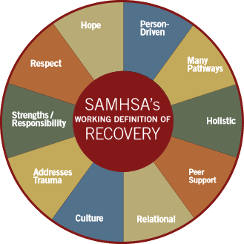
What Is Recovery?
What is recovery?
SAMHSA’s Working Definition
SAMHSA’s Working Definition
A process of change through which individuals improve their health and wellness, live self-directed lives, and strive to reach their full potential.
Access to evidence-based substance use disorder treatment and recovery support services are important building blocks to recovery
(Substance Abuse and Mental Health Services Administration, 2012)
Notes:
Guiding Principles of Recovery
Recovery emerges from hope: The belief that recovery is real provides the essential and motivating message of a better future—that people can and do overcome the internal and external challenges, barriers, and obstacles that confront them.
Recovery is person-driven: Self-determination and self-direction are the foundations for recovery as individuals define their own life goals and design their unique path(s).
Recovery occurs via many pathways: Individuals are unique with distinct needs, strengths, preferences, goals, culture, and backgrounds, including trauma experiences, that affect and determine their pathway(s) to recovery. Abstinence is the safest approach for those with substance use disorders.
Recovery is holistic: Recovery encompasses an individual’s whole life, including mind, body, spirit, and community. The array of services and supports available should be integrated and coordinated.
Recovery is supported by peers and allies: Mutual support and mutual aid groups, including the sharing of experiential knowledge and skills, as well as social learning, play an invaluable role in recovery.
Recovery is supported through relationship and social networks: An important factor in the recovery process is the presence and involvement of people who believe in the person’s ability to recover; who offer hope, support, and encouragement; and who also suggest strategies and resources for change.
Recovery is culturally based and influenced: Culture and cultural background in all of its diverse representations, including values, traditions, and beliefs, are keys in determining a person’s journey and unique pathway to recovery.
Recovery is supported by addressing trauma: Services and supports should be trauma-informed to foster safety (physical and emotional) and trust, as well as promote choice, empowerment, and collaboration.
Recovery involves individual, family, and community strengths and responsibility: Individuals, families, and communities have strengths and resources that serve as a foundation for recovery.
Recovery is based on respect: Community, systems, and societal acceptance and appreciation for people affected by mental illness and substance use disorders—including protecting their rights and eliminating discrimination—are crucial in achieving recovery.

Slide 56
Recovery Occurs in the Context of the Family
Substance use disorder is a disease that affects the family
Adults (who have children) primarily identify themselves as parents
The parenting role and parent-child relationship cannot be separated from treatment
Adult recovery should have a parent-child component including prevention for the child
(Ghertner et al., 2018; Radel et al., 2018)
Notes:
We know that recovery occurs within the context of relationships.
Substance use disorder is a disease that affects the family.
Adults (who have children) primarily identify themselves as parents, even if they don’t have physical custody of their child.
The parenting role and parent-child relationship cannot be separated from treatment.
Adult recovery should have a parent-child component, including prevention for the child.
***Ask participants what family recovery would look like. Create a family recovery definition.

Slide 57
Focusing Only on Parent’s Recovery Without Addressing the Needs of Children…
Can threaten parent’s ability to achieve and sustain recovery and establish a healthy relationship with their children, thus risking:
Recurrence of maltreatment
Re-entry into out-of-home care
Relapse and sustained recovery
Additional infants with prenatal substance exposure
Additional exposure to trauma for child/family
Prolonged and recurring impact on child well-being
(U.S. Department of Health and Human Services, 2013)
Notes:
Focusing only on the parent’s recovery issues without addressing the needs of the child and the family as a whole can threaten the parent’s ability to achieve and sustain recovery, to parent effectively, and to establish a healthy and positive relationship with their child(ren); thus risking:
Recurrence of maltreatment
Re-entry into out of home care
Relapse and sustained sobriety
Additional infants with prenatal substance exposure

Slide 58
A Family Focus
Parent Recovery
Parenting skills and competencies
Family connections and resources
Parental mental health
Medication management
Parental substance use
Domestic violence
Family Recovery and Well-being
Basic necessities
Employment
Housing
Child care
Transportation
Family counseling
Specialized parenting
Child Well-being
Well-being/behavior
Developmental/health
School readiness
Trauma
Mental health
Adolescent substance use
At-risk youth prevention
(Werner, Young, Dennis, & Amatetti, 2007)
Notes:
When serving a family holistically, the focus is on the parent’s recovery, the child’s well-being, and the family recovery and well-being as a whole.
Services to support a parent’s recovery should address:
Parenting skills and competencies
Family connections and resources
Parental mental health
Medication management
Parental substance use
Domestic violence
Services that support child well-being must address:
Well-being/behavior
Developmental/health
School readiness
Trauma
Mental health
Adolescent substance use
At-risk youth prevention
Supporting the entire family's recovery and well-being means providing:
Basic necessities
Employment
Housing
Child care
Transportation
Family counseling
Specialized Parenting

Slide 59
Recovery Support

Slide 60
Post-Treatment Expectations
Recovery as “one day at a time” for the rest of a person's life
Relapse
Ongoing support:
Economic, vocational, housing, parenting, medical, and social supports
Re-engagement in the recovery process, should relapse occur
Supporting recovery
(National Institute on Drug Abuse, 2018b)
Notes:
Recovery is a process.
The chronic nature of addiction means that for some people relapse, or a return to drug use after an attempt to stop, can be part of the process.
As with other chronic illnesses, relapses to drug use can occur and signals a need for treatment to be reinstated or adjusted. Individuals develop personal recovery plans in treatment, often call relapse prevention plans. If relapse occurs, an individual may need to re-enter treatment, enter a high level of treatment, or make adjustments to their recovery supports.
Recovery is a long-term process and frequently requires multiple episodes of treatment.
Continuing care and aftercare can support recovery, particularly after formal treatment has ended.

Slide 61
Continuing Care or Aftercare: Strategies To Support Recovery
Alumni group meetings at the treatment facility
Home visits from counselors
Case management
Parenting education and support services
Employment services
Safe and sober housing resources
Legal aid clinics or services
Notes:
In practice, many programs do not offer formal continuing care. In many cases, continuing care is an ongoing process of self-management and participation in voluntary, community-based recovery support networks.
However, there are a number of ways to provide support for recovery. Substance use disorder treatment professionals and child welfare workers play key roles in connecting parents and families to services that can support recovery and family healing. Some of the many important services to link parents to include:
Alumni group meetings at the treatment facility
Home visits from counselors
Case management
Parenting education and support services
Employment services
Safe and sober housing resources
Legal aid clinics or services

Slide 62
Continuing Care or Aftercare: Strategies To Support Recovery (cont’d)
Mental health services
Medical and healthcare referrals
Dental health care
Income supports
Self-help groups
Individual and family counseling
Recovery or peer support specialist
Notes:
You may also help connect a parent to these services as well:
Mental health services
Medical and healthcare referrals, including HIV testing and prevention programs
Dental health care
Income supports, including, when applicable, the Earned Income Tax Credit
Self-help groups, including 12-Step programs, such as AA and NA
Individual and family counseling
Recovery or peer support specialist

Slide 63
Functions of Recovery or Peer Support Specialists
Liaison
Links participants to ancillary supports; identifies service gaps
Treatment Broker
Facilitates access to treatment by addressing barriers and identifying local resources
Monitors participant progress and compliance
Enters case data
Advisor
Educates community; garners local support
Communicates with team, staff and service providers
(Huebner, 2018; Center for Substance Abuse Treatment, 2010)
Notes:
***Highlight any recovery support services in your community if they are available.
Recovery support could be case managers, peer recovery coaches, family mentors, recovery centers, etc.

Slide 64
A Program of the
Substance Abuse and Mental Health Services Administration
Center for Substance Abuse Treatment
and the
Administration on Children, Youth and Families
Children’s Bureau
Office on Child Abuse and Neglect
www.ncsacw.samhsa.gov
ncsacw@cffutures.org

Slide 65
References

Slide 66
References
Adams, P. J. (2016). Switching to a social approach to addiction: Implications for theory and practice. International Journal of Mental Health and Addiction, 14(1), 86–94.
American Psychiatric Association. (2013). Diagnostic and statistical manual of mental disorders (5th ed.). Arlington, VA: American Psychiatric Publishing.
American Society of Addiction Medicine. (2011). Public policy statement: Short definition of addiction. https://www.asam.org/docs/default-source/public-policy-statements/1definition_of_addiction_short_4-11.pdf?sfvrsn=6e36cc2_0
American Society of Addiction Medicine. (2014). The ASAM performance measures: For the addiction specialist physician. Chevy Chase, MD: American Society of Addiction Medicine. https://www.asam.org/docs/default-source/advocacy/performance-measures-for-the-addiction-specialist-physician.pdf?sfvrsn=5f986dc2_0
Barlow, A., McDaniel, J. A., Marfani, F., Lowe, A., Keplinger, C., Beltangady, M., & Goklish, N. (2018). Discovering frugal innovations through delivering early childhood home‐visiting interventions in low‐resource tribal communities. Infant Mental Health Journal, 39(3), 276–286. doi:10.1002/imhj.21711
Breshears, E. M., Yeh, S., & Young, N.K. (2009). Understanding substance abuse and facilitating recovery: A guide for child welfare workers. U.S. Department of Health and Human Services. Rockville, MD: Substance Abuse and Mental Health Services Administration. https://ncsacw.samhsa.gov/files/Understanding-Substance-Abuse.pdf
Bruns, E. J., Pullmann, M. D., Weathers, E. S., Wirschem, M. L., & Murphy, J. K. (2012). Effects of a multidisciplinary family treatment drug court on child and family outcomes: Results of a quasi-experimental study. Child Maltreatment, 17(3), 218–230.

Slide 67
References
Center for Substance Abuse Treatment. (2010). Substance abuse specialists in child welfare agencies and dependency courts: Considerations for program designers and evaluators. HHS Pub. No. (SMA) 10-4557 Rockville, MD: Substance Abuse and Mental Health Services Administration.
Center for Substance Abuse Treatment (US). (2014). Improving cultural competence. Rockville, MD: Substance Abuse and Mental Health Services Administration; Treatment Improvement Protocol (TIP) Series, No. 59, 1, Introduction to cultural competence. https://www.ncbi.nlm.nih.gov/books/NBK248431
Children and Family Futures. (2017). Collaborative values inventory. http://www.cffutures.org/files/cvi.pdf
Choi, S., & Ryan, J. P. (2006). Completing substance abuse treatment in child welfare: The role of co-occurring problems and primary drug of choice. Child Maltreatment, 11(4), 313–325. doi:10.1177/1077559506292607
Davis, D. P. (2007). NIDANotes: NIDA’s division of clinical neuroscience and behavioral research. https://archives.drugabuse.gov/news-events/nida-notes/2007/10/nidas-newest-division-mines-clinical-applications-basic-research
Ghertner, R., Baldwin, M., Crouse, G., Radel, L., & Waters, A. (2018). ASPE research brief: The relationship between substance use indicators and child welfare caseloads. https://aspe.hhs.gov/system/files/pdf/258831/SubstanceUseCWCaseloads.pdf
Green, B. L., Rockhill, A., & Furrer, C. (2007). Does substance abuse treatment make a difference for child welfare case outcomes? A statewide longitudinal analysis. Children and Youth Services Review, 29(4), 460–473. doi:10.1016/j.childyouth.2006.08.006
Grella, C. E., Hser, Y. I., & Huang, Y. C. (2006). Mothers in substance abuse treatment: Differences in characteristics based on involvement with child welfare services. Child Abuse & Neglect, 30(1), 55–73. doi:10.1016/j.chiabu.2005.07.005

Slide 68
References
Guerrero, E. G., Garner, B. R., Cook, B., & Kong, Y. (2017). Does the implementation of evidence-based and culturally competent practices reduce disparities in addiction treatment outcomes? Addictive Behaviors, 73, 119–123.
Huebner, R. A., Hall, M. T., Smead, E., Willauer, T., & Posze, L. (2018). Peer mentoring services, opportunities, and outcomes for child welfare families with substance use disorders. Children and Youth Services Review, 84, 239–246. doi:10.1016/j.childyouth.2017.12.005
Kim, H., & Hopkins, K. M. (2017). The quest for rural child welfare workers: How different are they from their urban counterparts in demographics, organizational climate, and work attitudes? Children and Youth Services Review, 73, 291–297. doi:10.1016/j.childyouth.2016.12.024
Longo, D. L. (2016). Neurobiologic advances from the brain disease model of addiction. New England Journal of Medicine, 374, 363–371.
Marsh, J. C., & Smith, B. D. (2011). Integrated substance abuse and child welfare services for women: A progress review. Children and Youth Services Review, 33(3), 466–472. doi:10.1016/j.childyouth.2010.06.017
McLellan, A. T., Lewis, D. C., O’Brien, & C. P., Kleber, H. D. (2000). Drug dependence, a chronic medical illness: Implications for treatment, insurance, and outcomes evaluation. The Journal of the American Medical Association, 284(13), 1689–1695.
Munoz, L. M. (2013). Preserving the bond: Child welfare professionals' perspectives on the opportunities and challenges of parent-child visitation. Dissertations. Paper 678. https://ecommons.luc.edu/cgi/viewcontent.cgi?referer=https://scholar.google.com/&httpsredir=1&article=1677&context=luc_diss
National Institute on Alcohol Abuse and Alcoholism. Overview of alcohol consumption. https://www.niaaa.nih.gov/alcohol-health/overview-alcohol-consumption

Slide 69
References
National Institute on Drug Abuse. (2007). The brain & the actions of cocaine, opioids and marijuana. Bethesda, MD: National Institutes of Health; U.S. Department of Health and Human Services. https://www.drugabuse.gov/brain-actions-cocaine-opioids-marijuana
National Institute on Drug Abuse. (2013). Methamphetamine. https://www.drugabuse.gov/publications/research-reports/methamphetamine
National Institute on Drug Abuse. (2016). Hallucinogens. https://www.drugabuse.gov/publications/drugfacts/hallucinogens
National Institute on Drug Abuse. (2018a). Commonly abused drugs charts. Bethesda, MD: National Institutes of Health; U.S. Department of Health and Human Services. https://www.drugabuse.gov/drugs-abuse/commonly-abused-drugs-charts
National Institute on Drug Abuse. (2018b). Drugs, brains, and behavior: The science of addiction. NIH Publication No. 18-DA-5605. Bethesda, MD: National Institutes of Health; U.S. Department of Health and Human Services. https://www.drugabuse.gov/publications/drugs-brains-behavior-science-addiction/preface
National Institute on Drug Abuse. (2018c). Principles of drug addiction treatment: A research-based guide (3rd ed.). Bethesda, MD: National Institutes of Health; U.S. Department of Health and Human Services. https://www.drugabuse.gov/publications/principles-drug-addiction-treatment-research-based-guide-third-edition
Oliveros, A., & Kaufman, J. (2011). Addressing substance abuse treatment needs of parents involved with the child welfare system. Child Welfare, 90(1), 25–41.
Park-Lee, E., Lipari, R. N., Bose, J., Hughes, A., Greenway, K., Glasheen, C., Herman-Stahl, M., Penne, M., Pemberton, M., & Cajka, J. (2018). Substance use and mental health issues among U.S.-born American Indians or Alaska Natives residing on and off tribal lands. CBHSQ Data Review. https://www.samhsa.gov/data

Slide 70
References
Radel, L., Baldwin, M., Crouse, G., Ghertner, R., & Waters, A. (2018). ASPE research brief: Substance use, the opioid epidemic, and the child welfare system: Key findings from a mixed methods study. https://aspe.hhs.gov/system/files/pdf/258836/SubstanceUseChildWelfareOverview.pdf
Roberts, S. C., & Nuru-Jeter, A. (2012). Universal screening for alcohol and drug use and racial disparities in child protective services reporting. The Journal of Behavioral Health Services & Research, 39(1), 3–16.
Roggman, L., & Cardia, N. (Eds.). (2016). Home visitation programs: Preventing violence and promoting healthy early child development. Springer International Publishing: Switzerland. doi: 10.1007/978-3-319-17984-1
Smith, V. C., & Wilson, C. R., AAP Committee on Substance Use and Prevention. (2016). Families affected by parental substance use. Pediatrics, 138(2), e20161575. doi: 10.1542/peds.2016-1575
Substance Abuse and Mental Health Services Administration. (2009). Substance abuse treatment: Addressing the specific needs of women. Treatment Improvement Protocol (TIP) Series, No. 51. HHS Publication No. (SMA) 13-4426. Rockville, MD: Substance Abuse and Mental Health Services Administration.
Substance Abuse and Mental Health Services Administration. (2012). SAMHSA’s working definition of recovery. Rockville, MD: Substance Abuse and Mental Health Services Administration. https://store.samhsa.gov/product/SAMHSA-s-Working-Definition-of-Recovery/PEP12-RECDEF
U.S. Department of Health and Human Services. (2013). Targeted grants to increase the well-being of, and to improve the permanency outcomes for, children affected by methamphetamine or other substance abuse: Fourth annual report to Congress. Washington, DC: Administration for Children and Families, Administration on Children, Youth and Families, Children’s Bureau. https://www.ncsacw.samhsa.gov/files/RPGI_4th_Report_to_Congress_reduced_508.pdf

Slide 71
References
U.S. Department of Health and Human Services (HHS), Office of the Surgeon General. (2016). Facing addiction in America: The Surgeon General’s report on alcohol, drugs, and health. Washington, DC: HHS. https://www.hhs.gov/surgeongeneral/reports-and-publications/addiction/index.html
Wells, M., Vanyukevych, A., & Levesque, S. (2015). Engaging parents: Assessing child welfare agency onsite review instrument outcomes. Families in Society, 96(3), 211–218.
Werner, D., Young, N. K., Dennis, K, & Amatetti, S. (2007). Family-centered treatment for women with substance use disorders: History, key elements and challenges. Washington, DC: U.S. Department of Health and Human Services, Substance Abuse and Mental Health Services Administration. https://www.samhsa.gov/sites/default/files/family_treatment_paper508v.pdf
Zweben, J. E., Moses, Y., Cohen, J. B., Price, G., Chapman, W., & Lamb, J. (2015). Enhancing family protective factors in residential treatment for substance use disorders. Child Welfare, 94(5), 145–166. https://www.ncbi.nlm.nih.gov/pubmed/26827469

Slide 72
Resources

Slide 73
Resources
Center for Substance Abuse Treatment. (2010). Substance abuse specialists in child welfare agencies and dependency courts considerations for program designers and evaluators. HHS Pub. No. (SMA) 10-4557 Rockville, MD: Substance Abuse and Mental Health Services Administration. https://ncsacw.samhsa.gov/files/SubstanceAbuseSpecialists.pdf
Center for Substance Abuse Treatment. (2015) Substance abuse treatment and family therapy. Treatment Improvement Protocol (TIP) Series, No. 39. HHS Publication No. (SMA) 15-4219. Rockville, MD: Substance Abuse and Mental Health Services Administration. https://store.samhsa.gov/product/TIP-39-Substance-Abuse-Treatment-and-Family-Therapy/SMA15-4219
Lander, L., Howsare, J., & Byrne, M. (2013). The impact of substance use disorders on families and children: From theory to practice. Social Work in Public Health, 28(3–4), 194–205. https://www.ncbi.nlm.nih.gov/pmc/articles/PMC3725219/
National Indian Child Welfare Association. (2015). Setting the record straight: The Indian Child Welfare Act fact sheet. https://www.nicwa.org/wp-content/uploads/2017/04/Setting-the-Record-Straight-ICWA-Fact-Sheet.pdf
National Institute on Drug Abuse. (2018). Commonly abused drugs charts. Bethesda, MD: National Institutes of Health; U.S. Department of Health and Human Services. https://www.drugabuse.gov/drugs-abuse/commonly-abused-drugs-charts
National Institute on Drug Abuse. (2018). Principles of drug addiction treatment: A research-based guide (3rd ed.). Bethesda, MD: National Institutes of Health; U.S. Department of Health and Human Services. https://www.drugabuse.gov/publications/principles-drug-addiction-treatment-research-based-guide-third-edition

Slide 74
Resources
Substance Abuse and Mental Health Services Administration. (2009). Substance abuse treatment: Addressing the specific needs of women. Treatment Improvement Protocol (TIP) Series, No. 51. HHS Publication No. (SMA) 13-4426. Rockville, MD: Substance Abuse and Mental Health Services Administration. https://store.samhsa.gov/product/TIP-51-Substance-Abuse-Treatment-Addressing-the-Specific-Needs-of-Women/SMA15-442
Substance Abuse and Mental Health Services Administration. (2016). A collaborative approach to the treatment of pregnant women with opioid use disorders: Practice and policy considerations for child welfare: Collaborating medical, and service providers. HHS Publication No. (SMA) 16-4978. Rockville, MD: Substance Abuse and Mental Health Services Administration. https://ncsacw.samhsa.gov/files/Collaborative_Approach_508.pdf
Substance Abuse and Mental Health Services Administration. (2018). Finding quality treatment for substance use disorders. https://store.samhsa.gov/product/Finding-Quality-Treatment-for-Substance-Use-Disorders/PEP18-TREATMENT-LOC
U.S. Department of Health and Human Services, Office of Minority Health. National culturally and linguistically appropriate services standards. https://www.thinkculturalhealth.hhs.gov/clas/standards

