Slide 1
Module 1: Understanding the Multiple Needs of Families Involved with the Child Welfare System
Child Welfare Training Toolkit

Slide 2
Acknowledgment
A program of the Substance Abuse and Mental Health Services Administration (SAMHSA) and the Administration for Children and Families (ACF), Children’s Bureau
www.ncsacw.samhsa.gov | ncsacw@cffutures.org
Notes:
This toolkit was developed by the National Center on Substance Abuse and Child Welfare (NCSACW), an initiative of the U.S. Department of Health and Human Services jointly funded by the Substance Abuse and Mental Health Services Administration's (SAMHSA) Center for Substance Abuse Treatment (CSAT) and the Administration on Children, Youth and Families (ACYF), Children's Bureau's Office on Child Abuse and Neglect (OCAN).

Slide 3
Learning Objectives
After completing this training, child welfare workers will:
Identify the prevalence of substance use and mental health disorders, and trauma in the child welfare population
Recognize the effects of substance use, mental health, trauma, and co-occurring disorders on children and families
Recognize the impact of bias and stigma from an agency perspective and a personal perspective
Understand the importance of a family-centered approach when working with families with co-occurring challenges
Identify the benefits of collaborating with other systems and service providers to better serve families
Notes:
The goal of Training Module 1 is to provide child welfare workers with information on a range of co-occurring needs that parents involved in the child welfare system may experience. This module discusses the needs of parents in the child welfare system who experience substance use disorders, mental health conditions, and trauma. Challenges related to bias and stigma are also presented. The module discusses the importance of a collaborative, family-centered approach to identifying and responding to families.
Module 1 of the Training Toolkit is a brief overview of areas that are covered in depth in other modules.

Slide 4
The Data

Slide 5
Prevalence of Parental Alcohol or Other Drug Use as a Contributing Factor for Reason for Removal by State, 2017
National Average: 37.7%
Note: Estimates based on all children in out-of-home care at some point during the fiscal year.
(U.S. Department of Health and Human Services, 2018)
Notes:
The numerator represents the number of kids, NOT the number of cases, who were in out-of-home care in FY 2017 and had parental alcohol or other drug use (AOD) listed as a reason for removal. The denominator is the total number of reasons for removal.
***What do you hear in your community about parental alcohol and other drug use as a reason for removal? How does this compare to where your state lands on this graph?
States typically do not agree with what this slide says in terms of their prevalence – many states say their prevalence is higher. This issue is related to:
Lack of protocols regarding identification (screening and assessment)
Lack of protocols regarding data entry
Variation in data systems
How alcohol or other drug use is captured in the state child welfare’s data systems (e.g., neglect; is there an alcohol and other drug box?)
Point in time in which the alcohol or other drug is identified and then entered in the data system
Often, at the local level, multiple child abuse and neglect reasons are reported and sometimes only the primary reason is reported by the federal system(s).
Total N with ANYAOD (numerator) FY 2017:
AK 70.0% 2876
AL 42.1% 3798
AR 49.5% 4232
AZ 30.7% 8260
CA 13.0% 10443
CO 42.6% 4502
CT 41.0% 2324
DC 14.2% 161
DE 12.7% 151
FL 48.4% 19224
GA 39.0% 7806
HI 31.3% 808
IA 57.9% 5437
ID 48.4% 1300
IL 10.1% 1993
IN 62.0% 19646
KS 45.1% 5025
KY 32.2% 4345
LA 5.4% 428
MA 30.3% 5075
MD 28.3% 1734
ME 56.9% 1503
MI 36.2% 6607
MN 44.1% 6996
MO 49.7% 9459
MS 48.5% 4042
MT 45.0% 2557
NC 41.2% 6372
ND 44.1% 1087
NE 36.8% 2413
NH 2.5% 51
NJ 42.0% 4260
NM 49.6% 2221
NV 17.2% 1297
NY 27.4% 6550
OH 29.3% 7390
OK 49.5% 7486
OR 59.6% 6640
PA 30.5% 8081
RI 33.6% 962
SC 18.6% 1406
SD 48.9% 1258
TN 32.4% 4286
TX 65.1% 32786
UT 60.6% 3070
VA 30.3% 2312
VT 25.7% 516
WA 41.8% 7020
WI 28.0% 3429
WV 51.4% 5365
WY 45.7% 943
Total US 37.7% 258,770
For more information on this data, visit https://ndacan.cornell.edu

Slide 6
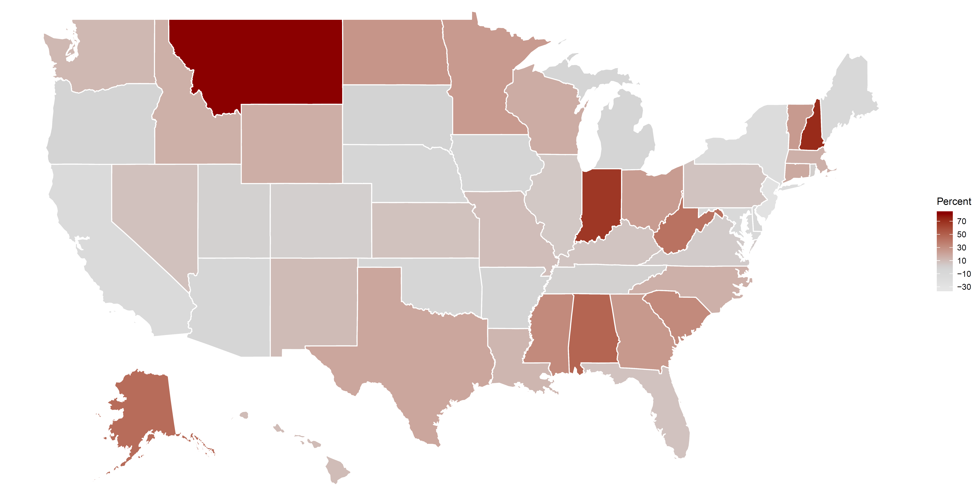
Percent Change of Children Placed in Out-of-Home Care (OOHC) by State, 2012–2017
72% of states (N = 37) had an increased rate of children placed in OOHC from 2012 to 2017.
Note: Estimates based on children who entered out-of-home care during the fiscal year.
(U.S. Department of Health and Human Services, 2018)
Notes:
This map shows the percentage change from 2012 to 2017 in all children placed in out-of-home care – these are entries to placement.
***Where is your state on this map? Are you seeing an increase in children placed in out-of-home care? Share with participants some of the reasons for increases in out-of-home care placement.

Slide 7
Percentage of Children Under Age 1 Who Entered OOHC in the United States, 2000–2017
Note: Estimates based on children who entered out-of-home care during the fiscal year.
(U.S. Department of Health and Human Services, 2018)
Notes:
This slide represents the percentage of infants who entered OOHC of all children removed during the fiscal year.
Explanation of data presented: Of all the children who entered OOHC during the fiscal year, the percentage of children under age 1 increased gradually from 13% (2000) to 18.6% (2017).
We are continuing to see a rise in the number of children under age 1 who are entering out-of-home care. This includes all reasons for removal, not just children who are removed due to their parent’s substance use.

Slide 8
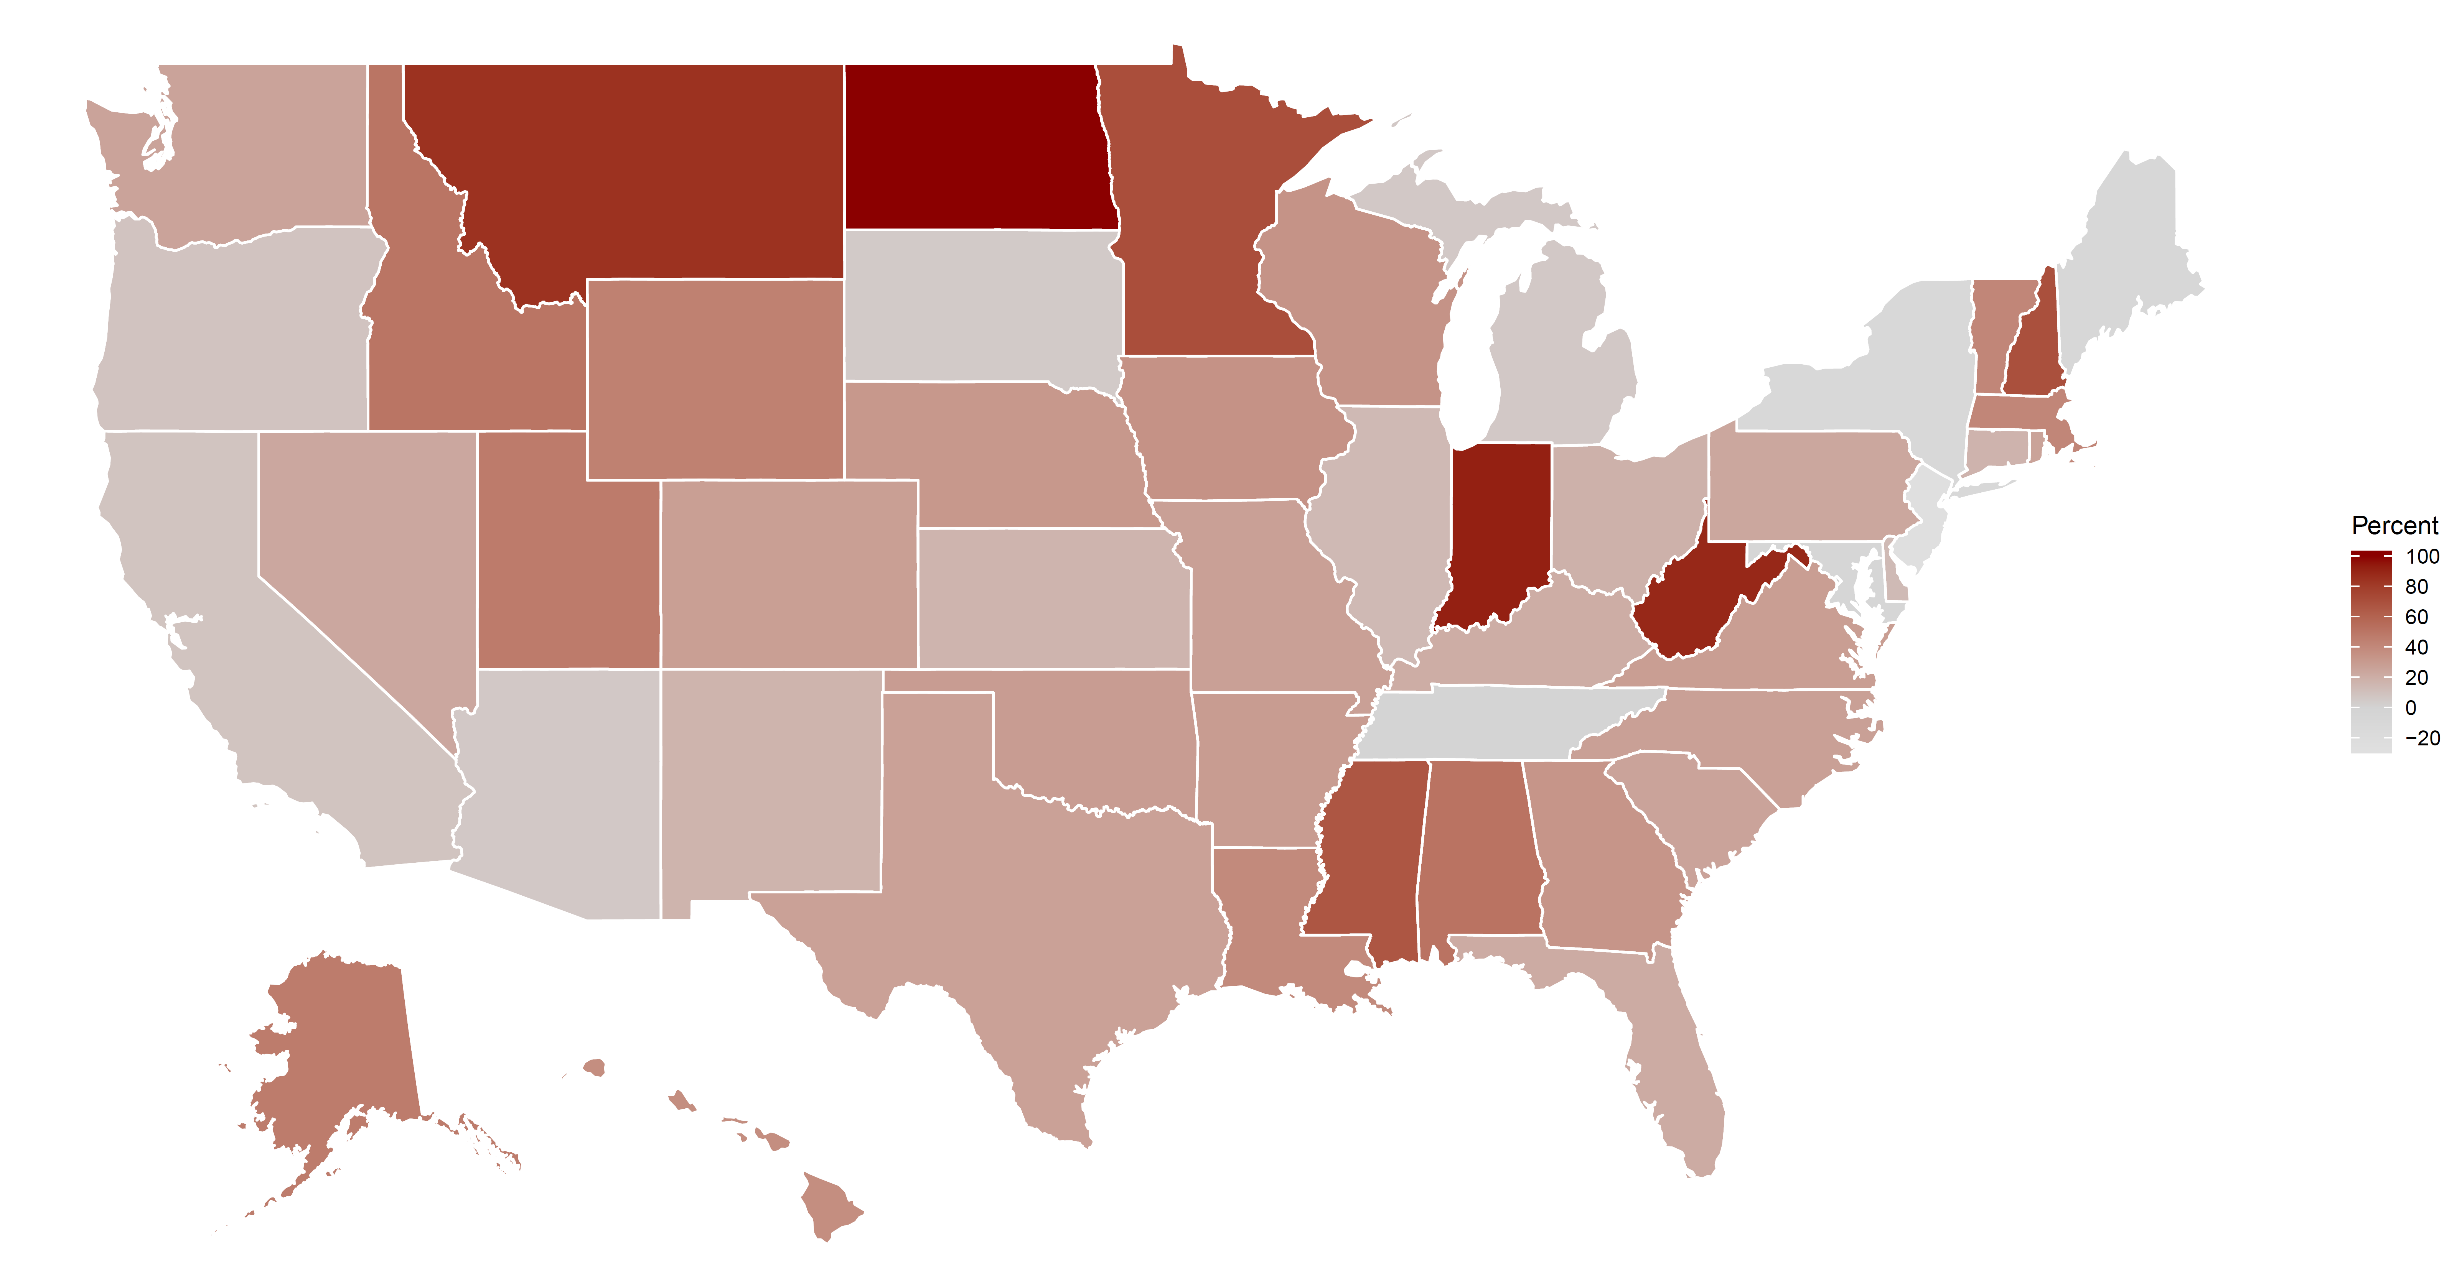
Percent Change of Children Under Age 1 Placed in Out-of-Home Care by State, 2012–2017
90% of states (N = 46) had an increased rate of children under age 1 placed in OOHC from 2012 to 2017.
Note: Estimates based on children who entered out-of-home care during the fiscal year.
(U.S. Department of Health and Human Services, 2018)
Notes:
This slide highlights the percent change from 2012 to 2017 for infants (under age 1) entering out-of-home care across all states.
It is important to reflect that many of the states across the West and Midwest northern border are not states that are typically thought of as experiencing the opioid crisis in the same way as some of the states in the northeast corridor. Yet, these northern border states are experiencing some of the higher rates of infants coming into care. It is important to understand that there are multiple reasons why infants may be coming into care at higher rates. Although not all states are experiencing the opioid crisis, many states are continuing to see high rates of methamphetamine use or other substances.
***Provide any state-specific data that might be relevant to understanding the reasons why children under age 1 are entering care in your state.

Slide 9
Office of the Assistant Secretary for Planning and Evaluation (ASPE) Study on Substance Use and Child Welfare
Identify the effect of substance use prevalence and drug death rates on child welfare caseloads, including:
Total reports of child maltreatment
Substantiated reports of child maltreatment
Foster care entries
(Radel et al., 2018)
Notes:
This slide provides some background information on the purpose and methods of the recent ASPE Study. The Office of the Assistant Secretary for Planning and Evaluation (ASPE) conducted a mixed-methods study, released in early 2018. The study investigated how substance use relates to child welfare caseloads and how parental substance use affects child welfare systems. They looked at rates of drug overdose deaths and rates of hospital stays and emergency department visits related to substances to measure substance use prevalence. They also conducted interviews and focus groups in states with high rates of opioid sales and drug overdose but variable changes in foster care rates.

Slide 10
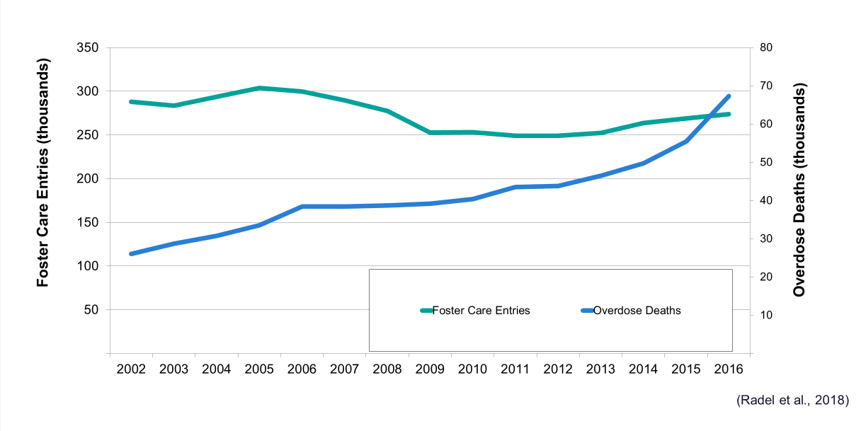
Comparison of Overdose Deaths and Foster Care Entries, 2002–2016
ASPE Study Findings: Overdose Deaths and Foster Care Caseloads, 2002 to 2016
Notes:
This slide highlights the ASPE Study comparison of the rate of overdose deaths and foster care entries within the U.S. from 2002 to 2016.
Overall, the study found that foster care entries and overdose deaths are related at the national level.
These data show that prior to 2012, foster care entries were generally declining, while overdose deaths rose. Following 2012, foster care entry rates began increasing; at the same time, drug overdose deaths began climbing at a faster rate.
There is variation in this relationship within the U.S. Some parts of the country show a stronger relationship, including:
Appalachia
Parts of the Pacific Northwest
Parts of the Southwest
Oklahoma
New England
***Why is all of this data important? The data highlight an increase in the number of children entering out-of-home placement, particularly children under age 1. The remainder of this module discusses the needs of parents in the child welfare system who experience substance use or co-occurring disorders. Early identification and access to treatment is critical due to timelines outlined in child welfare federal laws.

Slide 11
Child Welfare Laws
and Considerations
Notes:
Understanding the data is important, as there are child welfare federal laws and considerations that provide guidelines around placement and timeframes.
Early identification of the co-occurring needs of parents is critical when determining the interventions needed.

Slide 12
ASFA Timetables
When a child has been in foster care for 15 of 22 months, the state must request a petition to terminate parental rights, unless:
A relative is caring for the child,
There is a compelling reason that termination would not be in the best interests of the child,* or
The state has not provided the family the needed services within the required deadlines.
*For example, when the parent is participating and engaged in the substance use or mental health disorder treatment plan.
(Child Welfare Information Gateway, 2017)
Notes:
Review the Adoption and Safe Families Act (ASFA) timetables.

Slide 13
Time to Treatment Matters
Child Welfare
12-month timetable for permanency hearing
Treatment and Recovery
Ongoing process that may take longer
Conflicting Timetables
Parent–Child Relationship
Attachment, loss, and separation
Notes:
Child welfare cases move quickly. Each child is required to have a permanency hearing no later than 12 months after the child enters foster care to determine the permanency plan for the child. When a child has been in foster care for 15 of the most recent 22 months, the State must file a petition to terminate parental rights, unless one of the following three conditions applies: (1) a relative is caring for the child, (2) there is a compelling reason that termination would not be in the best interests of the child, or (3) the State has not provided the family the needed services within the required deadlines.
This timetable may move too quickly to give parents sufficient time to complete treatment or to demonstrate sufficient stability to care for their children. It is therefore essential that parents with substance use disorders get screened and identified, and that they access and engage in treatment as soon as possible. The other timetable to consider is a child’s development and the parent-child relationship. It is challenging to balance all of these needs.

Slide 14
Indian Child Welfare Act Protection
Purpose:
Protects the interests of American Indian families
Addresses the process and considerations for removing Indian children from their families
The Indian Child Welfare Act protects unmarried Indian youth under 18 years of age who are:
A member of a federally recognized Indian tribe, or
The biological child of a member of an Indian tribe and eligible for membership in a tribe
(Bureau of Indian Affairs, 2016)
Notes:
The Indian Child Welfare Act (ICWA) speaks to the importance of children to the continual presence and integrity of American Indian tribes and the state’s interest in protecting the important tribal relations and best interests of American Indian children. The act includes requirements regarding tribal authority, notice of and intervention in dependency hearings, entitlement of tribal acts and proceedings to credit the right of parents to court-appointed counsel, active efforts, evidentiary standards, and placement preferences. It requires dependency courts and child welfare workers to consider and recommend tribal customary adoption as an additional permanent placement option, without termination of parental rights, for a dependent child.
If the families you serve include members of American Indian tribes, you can learn more by visiting the National Indian Child Welfare Association website at http://www.nicwa.org. Please see the resource slide at the end of the presentation for more resources on IWCA.

Slide 15
Indian Child Welfare Act Protection
The most common violations are:
Failure to identify American Indian children
Failure to inform the tribe once children are identified
To fully participate in these provisions:
Make active efforts to contact the appropriate tribes
Involve the tribes in decisions about the family
Allow the tribe to take over the responsibility, if it wishes to do so
(Bureau of Indian Affairs, 2016)
Notes:
It is important to always ask if the child is a part of a tribe. All efforts must be made to identify American Indian children and include tribes in the decision-making.
***Include information on local tribes and your agency’s policy related to the Indian Child Welfare Act.

Slide 16
Substance Use Disorders and the Effects of Prenatal Substance Exposure on Infants, Parents, and Families

Slide 17
Effects of Prenatal Substance Exposure
American Academy of Pediatrics Technical Report
Comprehensive review of ~275 peer-reviewed articles over 40 years (1968–2006)
Long-Term
Short-Term
v
Birth Anomalies
Fetal Growth
Neurobehavioral Effects
Withdrawal
Achievement Behavior Cognition
Growth
Language
(Behnke & Smith, 2013)
Notes:
This slide highlights the effects of prenatal substance exposure from a comprehensive review of approximately 275 peer-reviewed articles spanning 40 years (1968–2006). While the article was published in 2013, the research it is based on is from articles published up to 2006, so there is still a great deal to learn about how prenatal substance exposure affects infants and children.
It is important to note that in practice it is rare to find a child who is exposed to only one substance. The point is not to compare across substances but to point out similarities in some developmental domains, to recognize that more research is needed, and to understand that polysubstance use should be expected when looking at developmental outcomes. The following points reiterate the need for further research on this topic:
This knowledge is very much in a state of flux, and we do not have all the information we need to make a firm conclusion about the effects of various substances.
Very few individuals are single substance users, so it is not easy to parse out the effects by substance.
While opioids have a strong effect on short-term withdrawal symptoms, other substances such as alcohol, cocaine, marijuana, and nicotine show more effects on long-term outcomes.
Prenatal exposure to alcohol has effects in 9 of 10 developmental domains studied, including short-term outcomes, birth outcomes, and long-term outcomes.
There are some substances and outcomes for which there is not a consensus or not enough data to come to a consensus.

Slide 18
Complex Interplay of Factors
Interaction of various prenatal and environmental factors:
Family characteristics
Family trauma
Prenatal care
Exposure to multiple substances (alcohol and tobacco)
Early childhood experiences in bonding with parents and caregivers
Other health and psychosocial factors
(American College of Obstetricians and Gynecologists, 2017; Bandstra et al., 2010; Baldacchino et al., 2014; Nygaard et al., 2016)
Notes:
Many factors influence how an infant is affected by prenatal and postnatal exposure to substances, not just the physical exposure to the substance in utero. Screening and assessing families helps us better understand the affect of parental substance use disorder on infants and children.
***Looking at the factors listed on this slide, use a flip chart to highlight each category. What are the types of information under each category that participants would want to know more information from families to help understand how an infant might be affected by the prenatal or postnatal environment? For example, under “family characteristics,” participants would want to gather information about the living situation, the substance use or co-occurring challenges among family members in the household, and family supports in place.
Continue to make a list of the types of information needed under each category.

Slide 19
Effect of Substance Use Disorders on Family Functioning
Child development
Household safety
Psychosocial impact
Parenting
Intergenerational factors
(Smith & Wilson, 2016)
Notes:
The life of a person with a substance use disorder is often out of balance, and the negative effects of use and misuse can have an enormous impact on his or her family and friends. The following categories show how substance use disorders negatively affect a family’s functioning across several domains.
Child development
Children may present with fetal alcohol syndrome or have a history of neonatal abstinence syndrome. Infants exposed to substances may experience a range of social, emotional, and behavioral effects as a result of exposure.
Household safety
Parents may neglect their child’s basic needs (e.g., empty cupboards, no adult supervision). Parental use may include manufacturing substances or selling drugs. Children may be exposed to harsh chemicals (i.e., those used in methamphetamine labs) or to dangerous and traumatic situations.
Psychosocial impact
Children may struggle with communication difficulties, overstimulation, or difficulty with emotional regulation. The postnatal environment may contribute to insecure attachment or other social-emotional concerns.
Parenting
Parent-child relationships may lack trust. Children may feel as though they must be the parent, resulting in feelings of anxiety and stress.
Parents may lack the skills to parent effectively, due to their own history as children of substance users.
Parent may use harsh discipline.
Intergenerational factors
Multiple generations of the family may be affected by substance use disorders.
Parents may lack basic family support, due to generational substance use disorders.
Family may present with issues of chronic neglect, due to the effects of long-term substance use disorders.

Slide 20
Substance Use Disorders, Mental Health Disorders, and Trauma in Child Welfare

Slide 21
Understanding Substance Use and Mental Health Disorders
Notes:
Substance use and mental health disorders present in many ways.

Slide 22
Co-Occurring Disorders
Substance use disorder
Mental health disorder
Co-occurring disorders
Notes:
A co-occurring disorder is when a person has a concurrent substance use and mental health disorder. Although substance use disorders and mental health disorders can impact individual families to varying degrees, there are also common challenges that families—and child welfare workers—need to be aware of, and to address thoughtfully.

Slide 23
Understanding Parents With Substance Use and Mental Health Disorders
Self-medicate untreated emotional or health problems
Manage untreated anxiety or depression
Express anger and discouragement
Punish themselves for failure
Escape negative aspects of their lives
(Lander, Howsare, & Byrne, 2013)
Notes:
Most parents with substance use or mental health disorders are not involved with the child welfare system. However, child welfare workers frequently identify substance misuse as a factor in child abuse or neglect cases and commonly identify mental health disorders in parents. It is important to assess all parents to understand their use of substances and any mental health concerns. Substance misuse can be the result of an underlying mental health disorder or other trauma that needs treatment. Case plans for these parents need to be coordinated across services. Addressing the needs of the parents, children, and other family members can improve outcomes for the whole family, in terms of both recovery for parents and safety, permanency, and well-being for children.

Slide 24
Protective and Risk Factors
Protective
Protective
Protective
Risk
Risk
Risk
Risk
(National Institute on Drub Abuse, 2003)
Notes:
Risk factors are characteristics at the biological, psychological, family, community, or cultural level that precede and are associated with a higher likelihood of negative outcomes.
Protective factors are characteristics associated with a lower likelihood of negative outcomes or that reduce a risk factor’s impact. Protective factors may be seen as positive countering events.
When assessing families, child welfare should look at the risk in families as well as the protective factors to understand risk and safety for children. The risk may be more obvious in the families that child welfare comes into contact with. Child welfare workers should not just try to eliminate risk, but must also build protective factors in families for long-term success. Protective factors are the strengths that support families through challenges.
***As a large group or in smaller groups, have the participants list examples of protective factors and risk factors.
Examples:
In relationships, risk factors include parents who use drugs and alcohol or who suffer from a mental health disorder, child abuse and maltreatment, and inadequate supervision. In this context, parental involvement is an example of a protective factor.
In communities, risk factors include neighborhood poverty and violence. Here, protective factors could include the availability of faith-based resources and after-school activities.
In society, risk factors can include norms and laws favorable to substance use, as well as racism and a lack of economic opportunity. Protective factors in this context would include hate crime laws or policies limiting the availability of alcohol.

Slide 25
Behavior Interventions
Lack of engagement
Outreach
Refusal to comply
Warm hand-offs
Lack of follow- through
Recovery support
Notes:
The physical impact of substance use or mental health disorders on the brain may lead to parental behaviors that are labeled resistant. Child welfare workers can use engagement strategies to intervene when these behaviors present themselves.
Child welfare workers can help families access community supports. In the past, the message we would hear is to not enable families. The assumption was if they wanted treatment, they would make sure they got to treatment and services. Families don’t need to “prove” their motivation. Helping families access community treatment and supports is not enabling the family.
If families are not making it to services, find out why. What other supports can you put in place?
If families don’t want to go to treatment, how can you use engagement strategies? What are they willing to attend for services?
If families are not following through with treatment, what supports can you put in place to support treatment?

Slide 26
Effects of Trauma
Attachment and relationships
Physical health: body and brain
Emotional responses
Dissociation
Behavior
Cognition: thinking and learning
Self-concept and future orientation
Economic impact
(National Child Traumatic Stress Network, n.d.)
Notes:
Trauma can affect all aspects of a person, from their own behavior and responses to the relationships they have with others.
SAMHSA’s concept of trauma: “Individual trauma results from an event, series of events, or set of circumstances that is experienced by an individual as physically or emotionally harmful or life threatening and that has lasting adverse effects on the individual’s functioning and mental, physical, social, emotional, or spiritual well-being.”
Examples of adverse effects include an individual’s inability to cope with the normal stresses and strains of daily living; to trust and benefit from relationships; to manage cognitive processes, such as memory, attention, and thinking; to regulate behavior; or to control the expression of emotions. Individuals may not make the connection of their thoughts and behaviors to their trauma.

Slide 27
Substance Use Disorder, Mental Health Disorders, and Trauma
An estimated 10%–11% of the 4.1 million live births annually involve prenatal exposure to alcohol or drugs.
Parents with substance use disorders often have a history of trauma, with 60%–90% of treatment participants experiencing one or more traumatic events.
Families affected by substance use disorders who are involved in the child welfare system need a system of care that recognizes the impact of trauma on their functioning and recovery.
In a trauma-informed organization, every part of the organization–from management to service delivery–has an understanding of how trauma affects the life of an individual seeking services.
Roughly 7.9 million adults had co-occurring mental health and substance use disorders in 2014.
Just over 42% of persons seeking substance use disorder treatment have been diagnosed with co-occurring mental health and substance use disorders.
(Center for Substance Abuse Treatment, 2000; Dube et al., 2003; Felitti et al., 1998; Greeson et al., 2011; Kisiel et al., 2014)
Notes:
Failure to understand and address trauma may lead to lack of engagement in services, increase in symptoms, re-traumatization, increase in relapse, withdrawal from the service relationship, and poor treatment outcomes. Growing up in a home with exposure to adverse, traumatic childhood experiences is associated with lifelong physical, emotional, psychological, and social challenges.
The Adverse Childhood Experiences (ACE) Study demonstrated the clear linkage between childhood trauma and future substance use disorders, finding that compared to persons with no exposure to ACEs, adults with five or more ACEs were seven to ten times more likely to have illicit drug use problems, and two times more likely to be an alcoholic. Children raised with a parent or caretaker who abused alcohol were found to have a significantly greater risk of experiencing all other ACEs. Children living with parents who abused substances were almost five times more likely to have experienced a traumatic event and twice as likely to have a stress response to the traumatic event, compared to children who were not exposed to caregiver substance use disorders. Early traumatic events such as exposure to family violence and physical abuse, can lead to a greater risk of developing post-traumatic stress disorder (PTSD), which has been shown to significantly increase the likelihood of a substance use disorder among older youth in foster care.

Slide 28
Women’s Experiences of Co-Occurring Disorders, Trauma, and Domestic Violence
Childhood Abuse
Women with substance use disorders are more likely to report a history of childhood abuse.
Physical, sexual, and/or emotional abuse
Trauma
Many women with substance use disorders experienced physical or sexual victimization in childhood or in adulthood, and may suffer from PTSD.
Alcohol or drug use may be a form of self-medication for people with PTSD and other mental health disorders.
(Substance Abuse and Mental Health Services Administration, 2009)
Notes:
Women who have had challenging life experiences, such as childhood abuse, trauma, domestic violence, or a combination of these can be at higher risk for substance use disorders.
Childhood abuse
A number of studies suggest that women with substance-related problems are more likely to report a history of childhood abuse—physical, sexual, and/or emotional—than are women without substance-related problems.
Trauma
Many women with substance use disorders have experienced physical or sexual victimization in childhood or in adulthood. And studies have shown that, among people with substance use problems, those with histories of childhood abuse are more likely to suffer from trauma and PTSD. Alcohol or drug use may serve as a form of self-medication for people with PTSD and other mental health disorders.

Slide 29
Women’s Experiences of Co-Occurring Disorders, Trauma, and Domestic Violence
Domestic Violence
Women who have a substance use disorder are more likely to become victims of domestic violence.
Victims of domestic violence are more likely to become dependent on tranquilizers, sedatives, stimulants, and painkillers, and are more likely to abuse alcohol.
Co-Occurring Disorders
Childhood abuse and neglect may contribute to anxiety, depression, PTSD, dissociative disorders, personality disorders, self-mutilation, and self-harming in adults.
Among individuals with substance use problems, more women than men have a secondary diagnosis of a mental health disorder.
(Khoury et al., 2010; Substance Abuse and Mental Health Services Administration, 2009)
Notes:
Domestic Violence
Women who have a substance use disorder are more likely to become victims of domestic violence. Victims of domestic violence are also more likely to become dependent on tranquilizers, sedatives, stimulants, and painkillers and are more likely to misuse alcohol.
Co-Occurring Disorders
Conditions associated with childhood abuse and neglect, which may co-occur with substance use disorders, include anxiety, depression, and PTSD, as well as dissociative disorders, personality disorders, self-mutilation, and self-harming. We will cover these disorders in an upcoming training module. Among individuals with substance use problems, more women than men have a secondary diagnosis of a mental health disorder. Women may experience any one of these conditions, or a combination of several.

Slide 30
Additional Stressors
Co-occurring substance use and mental health disorders
Limited educational and vocational opportunities
Limited fiscal resources
Criminal involvement
Physical illnesses
Difficult and traumatic life experiences
(Center for Behavioral Health Statistics and Quality, 2015)
Notes:
Co-occurring substance use and mental health disorders, such as PTSD, anxiety disorders, depression, and bipolar disorders, can affect the daily behavior of parents toward their children and their ability to focus on their children’s needs.
The relationship between poverty, substance use, and mental health disorders is not well-defined. Some studies suggest that the stress of poverty increases the likelihood that substance use and mental health disorders may develop, while some information suggests that substance use and mental health disorders increase the likelihood of poverty. Either way, having limited educational, vocational, and fiscal resources make the consequences of substance use and mental health disorders more visible—and certainly can affect parents’ ability to earn a living and provide for their children.
Parents may also be involved with the legal system for criminal activities. These criminal activities may be a result of substance use (e.g., possession of an illegal substance), may be related to an effort to obtain money for purchasing illicit substances (e.g., prostitution or theft), or may be a result of a mental health disorder. Criminal involvement can affect parents’ ability to provide for their children (because of incarceration) and, depending on the type of criminal involvement (e.g., selling drugs), may put the children at risk through contact with dangerous individuals or dangerous situations. One caveat. It is important for us to be aware that, despite media attention connecting violence and mental health disorders, the vast majority of people with severe mental health disorders are neither involved in criminal activity nor violent. If someone with a mental health disorder is incarcerated, it is more likely to be for a crime of noncompliance, such as loitering, trespassing, or resisting authority.
Parents with substance use disorders may suffer from a variety of physical health issues—some of which may be a result of their substance use. However, physical health issues may also be an effect of having limited financial resources and thus lacking appropriate health care. Physical illnesses can affect a parent’s stamina and the ability to care for children over a period of time.
Difficult and traumatic life experiences—things like childhood experiences of abuse or neglect, domestic violence, or homelessness—may have interrupted the parent’s development as a child. And they may have deprived them of normal parental role models and life experiences.

Slide 31
Stigma

Slide 32
Confronting Stigma
Stigma associated with substance use disorder:
“The Stigma of Addiction”: https://www.youtube.com/watch?v=LDsIGHEGj6w
Stigma associated with mental health disorder:
“What Is Stigma?”: https://www.youtube.com/watch?v=9vkUMXaJDM4
Notes:
Understanding and addressing stigma is an important part of working with families.
***Before you show these two video clips, ask participants to get out a piece of paper to write down their answers. Their answers will not be shared with the group.
What is the first thing that comes to your mind when you hear the following (pause between words to give the participant time to answer):
Addict
Mentally ill
Recovery
Now show the clips about stigma. Have a discussion on identifying participants’ biases and beliefs.

Slide 33
Stigma
Two main factors affect the burden of stigma placed on a particular disease or disorder:
Perceived control that a person has over the condition
Perceived fault in acquiring the condition
(Education Development Center, 2017)
Notes:
For people with a substance use disorders, stigma disproportionately influences health outcomes and mental well-being. Fear of being judged or discriminated against can prevent people with substance use disorders, or those who are at risk of having substance use disorders, from getting the help they need.

Slide 34
Stigma
Affects the attitudes of…
Medical and healthcare professionals
Social service agencies and workers
Families and friends
Creates barriers to treatment and impedes access to programs
Influences policies
(Center for Substance Abuse Treatment, 2008)
Notes:
Stigma permeates community institutions and affects the attitudes of service professionals and criminal justice agencies, and impacts policies.
Stigma discourages people from accessing early treatment and remaining in services.
Stigma also affects the location and access of programs to help people recover from substance use disorders.

Slide 35
Stigma and Perceptions
Perceptions about people with substance use disorders:
Once an addict, always an addict
They don’t really want to change
They lie
They must love their drug more than their child
They need to get to rock bottom, before…
Notes:
Many people have had their own experiences with a person who has a substance use disorder. Your experience may affect the way you view someone who uses drugs or alcohol, particularly when you are thinking about how children are affected. It is important to recognize your own thoughts and perceptions as you approach this work.

Slide 36
Combating Stigma
Are you using person-first language?
Are you using technical language with a single, clear meaning instead of colloquialisms or words with inconsistent definitions?
Are you conflating substance use and a substance use disorder?
Are you using sensational or fear-based language?
Are you unintentionally perpetuating drug-related moral panic?
(Center for Substance Abuse Treatment, 2008)
Notes:
How can child welfare workers address stigma in their everyday practice? Words matter. Consider the language you use when talking about or to families. Person-first language (for example, a reference to “a person with substance use disorder”) suggests that the person has a problem that can be addressed. By contrast, calling someone a “drug abuser” implies that the person is the problem. Consider the difference between the terms “negative urine drug screen” and “clean urine.” The first is a clear description of test results; the second a value-laden term that implies drug use creates “dirty” urine.
While some substance use may be illegal or unhealthy, we should limit language about substance use disorders exclusively to situations where a clinical diagnosis has been made.
Referring to emerging drug threats as “newer,” “bigger,” “scarier,” or “unlike anything ever seen before” can be perceived as inauthentic by people who use those substances. It further compounds stigma by conveying the message that anyone who uses such a “terrible” substance is stupid, dangerous, or illogical. From publicizing stories about “crack babies” in the 1980s to “opioid babies” today, the tendency toward moral panic has a long history in prevention messaging and media coverage of substance use disorders. Moral panic inevitably marginalizes people who are vulnerable and often brings their morality or even humanity into question.

Slide 37
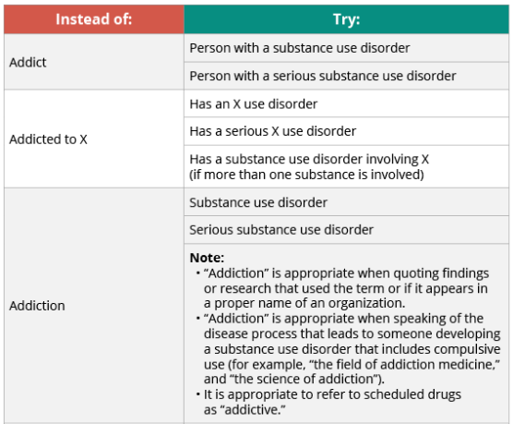
Language Considerations
(White House Office of National Drug Control Policy, 2015)
Notes:
The next few slides highlight language changes that can assist in combating stigma.
Review the person-first language.

Slide 38
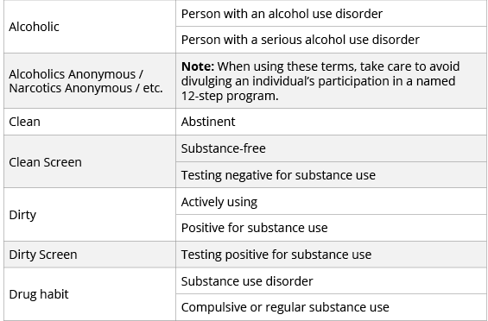
Language Considerations
(White House Office of National Drug Control Policy, 2015)
Notes:
Continue to review the language.
***Can the training participants come up with other examples of language that can be stigmatizing? What are some language considerations for those examples?

Slide 39
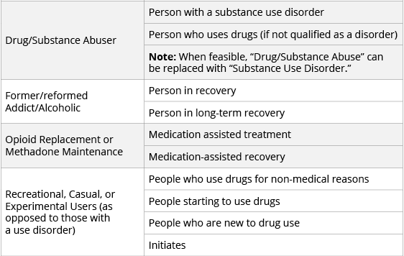
Language Considerations
(White House Office of National Drug Control Policy, 2015)
Notes:
Continue to review the language.
***Can the training participants come up with other examples of language that can be stigmatizing? What are some language considerations for those examples?

Slide 40
Treatment

Slide 41
A Treatable Disease
Substance use disorders are preventable and treatable.
Discoveries in the science of addiction have led to advances in substance use disorder treatment that help people stop misusing drugs and resume productive lives.
Treatment enables people to counteract addiction’s powerful disruptive effects on the brain circuitry and behavior and regain areas of life function.
Successful substance use disorder treatment is highly individualized and entails:
Medication
Behavioral interventions
Peer support
“Groundbreaking discoveries about the brain have revolutionized our understanding of addiction, enabling us to respond effectively to the problem.”
—Dr. Nora Volkow, National Institute on Drug Abuse
(National Institute on Drug Abuse, 2018; Longo, 2016)
Notes:
A substance use disorder is a treatable disease.
Treatment needs to be individualized to be most effective.
This slide highlights the importance of treatment and how treatment can be successful.

Slide 42
Purpose of Treatment
Treatment Outcomes
Treatment Outcomes
Reduce the major symptoms of the illness.
Improve health and social functioning.
Teach and motivate individuals to monitor their condition and manage threats of relapse.
Substance use disorder treatment is classified into different modalities—detoxification, residential treatment, outpatient treatment, medication-assisted treatment, aftercare, and community supports.
(National Institute on Drug Abuse, 2018)
Notes:
Research indicates that most individuals with substance use disorders need at least three months in treatment to significantly reduce or stop their drug use and that the best outcomes occur with longer durations of treatment.
According to research that tracks individuals in treatment over extended periods, most people who enter and remain in treatment stop using drugs, decrease their criminal activity, and improve their occupational, social, and psychological functioning.
Treatment enables people to counteract a substance use disorder’s powerful disruptive effects on the brain and behavior and to regain control of their lives. Treatment also helps individuals understand relapse triggers and how to plan for relapse.
Review the treatment modalities in your community.
***For further information about substance use disorder treatment, please see Module 2: Understanding Substance Use Disorders, Treatment, and Recovery.

Slide 43
Overview of the Treatment Process
Overview of the Treatment Processes
Early Identification, Screening,
and Brief Intervention
Done at earliest point possible
Determine extent and severity of disease
Comprehensive Assessment
Stabilization
Via medically supervised detoxification, when necessary
Timely and Appropriate Substance Use Disorder Treatment
Address substance use disorder and co-occurring issues
Help parents sustain recovery, maintain family safety and stability
Continuing Care and Recovery Support
(American Society of Addiction Medicine, 2014)
Notes:
When child welfare workers have concerns that a parent may have a substance use disorder, they will need to refer the parent to substance use disorder treatment. This slide provides a general overview of the treatment process from assessment through ongoing support.

Slide 44
Assessment of Co-Occurring Disorders
Three possible paths:
1. One person does an assessment for both substance use and mental health disorder.
2. Assessment of substance use disorder leads to referral and assessment for a mental health disorder.
3. Assessment of mental health disorder leads to referral and assessment for a substance use disorder.
Not all treatment professionals are cross-trained to conduct both assessments, nor do they always actively look for co-occurring disorders.
Notes:
The presenter can ask which of these three paths are used in the participants’ counties or states. Is it 1, 2, or 3? Not all treatment professionals are cross-trained to conduct both assessments, nor do they always actively look for co-occurring disorders. This is very important to talk recognize.
***Discuss how assessment looks in different counties or states.

Slide 45
Research-Based Approaches for Treating Women
Treatment Models
Relationship-based; peer support, family support, and affinity groups
Child care, transportation, economic support, and vocational/job services
Parenting Role
Parenting role cannot be separated from treatment.
Treatment programs that accommodate mothers with their children establish trust and engagement.
(Center for Substance Abuse Treatment, 2009; Werner et al., 2007)
Notes:
Treatment Models
Treatment for women needs to be relationship-based. Peer support, family support, and affinity groups are common characteristics needed for supportive change to occur. Treatment also needs to address concrete services, such as child care, transportation, economic support, and vocational or job services.
Parenting Role
Treatment for mothers with substance use disorders must address their roles as parents. Many of these women have not learned to be good parents, may not know about normal child development, and may have unrealistic expectations of their children. Parenting time is important.
Others may have been positive parents. However, their positive parenting abilities may have been compromised because of the loss of balance and wellness caused by the substance use disorder, particularly as the substance use cycle intensifies.
When a parent has a substance use disorder, numerous safety considerations arise for the children, which child welfare workers are responsible for addressing. These issues are discussed further in Module 6: Understanding the Needs of Children of Parents with Substance Use or Co-Occurring Disorders. Treatment programs that accommodate women and children are generally more successful at establishing trust and engaging mothers. It is essential for women to feel safe and assured that their children are being cared for during the treatment process.

Slide 46
Healthy Relationships for Fathers
Fostering healthy relationships between fathers and children is integral to recovery from substance use and mental health disorders and development of parenting skills.
Both parents should be involved in the lives of their children to the extent that children are safe and protected.
The dependency court and child welfare systems are required to make reasonable efforts to locate absent fathers.
(Neger & Prinz, 2015)
Notes:
The presenter can speak about healthy relationships for birth parents. Fostering healthy relationships between fathers and children is integral to a father’s recovery from substance use and mental health disorders and the development of parenting skills. Although mothers are most often the individuals in treatment and may be reluctant to involve fathers, especially if there are safety concerns, both parents should be involved with child welfare and treatment services whenever possible. Both parents should also be involved in the lives of their children to the extent that children are safe and protected. Furthermore, the dependency court and child welfare systems are mandated to locate absent fathers.

Slide 47
A Family Focus
Parent Recovery
Parenting skills and competencies
Family connections and resources
Parental mental health
Medication management
Parental substance use
Domestic violence
Family Recovery and Well-Being
Basic necessities
Employment
Housing
Child care
Transportation
Family counseling
Specialized parenting
Child Well-Being
Well-being/behavior
Development/health
School readiness
Trauma
Mental health
Adolescent substance abuse
At-risk youth prevention
(Werner, Young, Dennis, & Amatetti, 2007)
Notes:
When serving a family holistically, the focus is on the parent’s recovery, the child’s well-being, and the family’s recovery and well-being as a whole.
Services to support the parent’s recovery should address:
Parenting skills and competencies
Family connections and resources
Parental mental health
Medication management
Parental substance use
Domestic violence
Services that support child’s well-being must address:
Well-being/behavior
Development/health
School readiness
Trauma
Mental health
Adolescent substance use
At-risk youth prevention
Supporting the entire family's recovery and well-being means providing:
Basic necessities
Employment
Housing
Child care
Transportation
Family counseling
Specialized parenting

Slide 48
Recovery Occurs in the Context of the Family
Recovery Occurs in the Context of the Family
A substance use disorder is a disease that affects the family.
Adults (who have children) primarily identify themselves as parents.
The parenting role and parent–child relationship cannot be separated from treatment.
Adult recovery should have a parent–child component including substance use prevention for the child.
(Ghertner et al., 2018; Radel et al., 2018)
Notes:
We know that recovery occurs within the context of relationships.
A substance use disorder is a disease that affects the family.
Adults (who have children) primarily identify themselves as parents, even if they don’t have physical custody of their child.
The parenting role and parent–child relationship cannot be separated from treatment.
Adult recovery should have a parent–child component including substance use prevention for the child.
***Ask participants what they think family recovery would look like. Create a family recovery definition.

Slide 49
Family-Centered Approach
Recognizes that addiction is a brain disease that affects the entire family and that recovery and well-being occurs in the context of the family.
(Adams, 2016; Bruns et al., 2012)
Notes:
When child welfare workers and substance use treatment providers working with families with substance use disorders recognize that substance use disorders are a brain disease rather than a personal failing or chosen behavior, it can help to reduce stigma.
Reducing stigma ensures that clients are seen as whole people. Child welfare workers and substance use treatment providers can identify client strengths and recognize opportunities to improve parenting and support the parent–child relationship so that families can stay together safely.
Viewing the family as a system requires a shift in thinking for child welfare workers who have traditionally focused on their mission of safety and well-being of the child, and substance use treatment providers, who traditionally have focused on treatment and recovery of the parent. Child safety and parental recovery are critically linked to one another and must be addressed holistically to ensure the best outcomes for the entire family.

Slide 50
Principles of Family-Centered Treatment
Principles of Family-Centered Treatment
Treatment is comprehensive and inclusive of substance use disorder treatment, clinical support services, and community supports for parents and their families.
The caretaker defines “family,” and treatment identifies and responds to the effect of substance use disorders on every family member.
Families are dynamic, and thus treatment must be dynamic.
Conflict within families is resolvable, and treatment builds on family strengths to improve management, well-being, and functioning.
Cross-system coordination is necessary to meet complex family needs.
(Werner et al., 2007)
Notes:
Currently, there is no universally accepted definition of “family-centered treatment.” Provider approaches may differ along a continuum, from family involvement (a minimum standard of service) to family-centered services (in which children or other family members may receive their own services) to full comprehensive family-based treatment (in which all members of the family have individualized case plans and share an integrated family plan).
Despite this variation, some common principles underlie family-centered treatment, including:
It is comprehensive and includes clinical treatment for substance use disorders, clinical support services, and community supports for parents and their families. Services often include recovery coaches or mentors, case management, aftercare services, access to co-occurring services, or other identified needs for the parent and the family.
It focuses on the entire family unit as opposed to the individual parent with a substance use disorder. Women/parents define their families and treatment identifies and responds to the impact of substance use disorders on every family member
Treatment is based on the unique needs and resources of individual families.
Families are dynamic, and thus treatment must be dynamic.
Conflict within families is inevitable, but resolvable. Treatment offers whole-family services that build on family members’ strengths to improve family management, well-being, and functioning.
Meeting complex family needs requires coordination across systems.
Services must be gender-responsive and specific and culturally competent.
Family-centered treatment requires an array of professionals and an environment of mutual respect and shared training.
Safety of all family members comes first.
Treatment must support creation of healthy family systems.

Slide 51
Benefits of Family-Centered Substance Use Disorder Treatment
Mothers who participated in the Celebrating Families! Program and received integrated case management showed significant improvements in recovery, including reduced mental health symptoms, reduction in risky behaviors, and longer program retention (Zweben et al., 2015).
Women who participated in programs that included a “high” level of family and children’s services were twice as likely to reunify with their children as those who participated in programs with a “low” level of these services (Grella, Hser, & Yang, 2006).
Retention and completion of comprehensive substance use treatment have been found to be the strongest predictors of reunification with children for parents with substance use disorders (Green, Rockhill, & Furrer, 2007; Marsh, Smith, & Bruni, 2011).
Notes:
Review the outcomes of family-centered treatment.

Slide 52
Collaboration

Slide 53
Improving Communication: No Single Agency Can Do This Alone
Improving the outcomes of children and families affected by parental substance use requires a coordinated response that draws from the talents and resources of at least the following systems:
Child welfare
Substance use treatment
Courts
Health care
Better Together
(Children and Family Futures, 2011)
Notes:
We know that no agency can tackle the issue of substance use disorders and child maltreatment on its own—it requires a coordinated response that draws on the talents and resources of many agencies. Serving families with substance use disorders who are involved with child welfare requires a response not just child welfare, substance use treatment, and the courts, but also health care, early childhood, mental health, education, and other community providers.

Slide 54
The Need to Do Better for Families
Substance use disorders can negatively affect a parent’s ability to provide a stable, nurturing home and environment. Of children in care, an estimated 61% of infants and 41% of older children have at least one parent who is using drugs or alcohol (Wulczyn, Ernst, & Fisher, 2011).
Families affected by parental substance use disorders have a lower likelihood of successful reunification with their children, and their children tend to stay in the foster care system longer than children of parents without substance use disorders (Brook & McDonald, 2009).
The lack of coordination and collaboration between child welfare agencies, community partners, and substance use disorder treatment providers undermines the effectiveness of agencies’ response to families (Radel et al., 2018).
Notes:
Child welfare workers, courts, substance use disorder treatment providers, and community partners need to work together to address parents’ substance use disorders to prevent removal and provide services to support child permanency with their families.
The process of engaging and retaining parents with substance use disorders in screening and assessment, treatment, and in moving from treatment to lifelong recovery is multifaceted and complex. This process requires input and services from a variety of providers, the child welfare agency, and the court. Coordination by professionals across these disciplines will help parents navigate the road to sustained recovery.

Slide 55
Collaboration
Child welfare workers
Substance use professionals
Must collaborate to develop a case plan that is mutually supportive for their shared client
Mental health professionals
Notes:
Treatment providers and child welfare workers need to work together to improve outcomes for families. This collaboration must happen with appropriate signed releases in place. Collaboration can happen through in-person meetings, phone calls, and progress reports and updates.

Slide 56
Benefits of Collaboration
Contributes to better outcomes and efficiencies in the service delivery systems.
The investment of time leads to better shared understanding, improved planning efficiency, and more effective monitoring of parental progress.
Collaboration in case planning and information sharing can include child welfare workers, substance use treatment providers, mental health treatment providers, court professionals and other related service professionals.
Notes:
Many of the parents in child welfare have substance use or mental health disorders, or both, and we should also be clear that treatment and recovery are clearly in the best interest of their children. Collaboration benefits parents, children, and families when child welfare workers collaborate with treatment professionals to sustain and strengthen family relationships.
Building collaborative relationships with treatment agencies takes time, but the research shows better outcomes for the clients. The investment will lead to a better understanding of these families and the challenges they are facing, better planning, and more effective monitoring. In the end, these partnerships will contribute to better outcomes for these families.

Slide 57
Collaboration
Collaboration can provide many benefits to families in treatment.
Families experience benefits when child welfare workers understand the context of the parent’s substance use and/or mental health disorders and how treatment works.
Collaboration promotes these benefits for families:
Improves family engagement
Improves planning and family outcomes
Reduces family stress
Helps families meet requirements
Improves information sharing
(Center for Substance Abuse Treatment, 2004)
Notes:
Families benefit when child welfare workers understand something of a parent’s substance use and/or mental health disorder and how their treatment works—and when they collaborate with the agencies that provide this treatment. Here are a few of the benefits:
Collaboration improves family engagement. Parents with substance use or mental health disorders who are not involved in the child welfare system often know their children are in trouble or endangered. They may avoid or leave treatment for fear of losing their children. When child welfare workers and treatment professionals collaborate and can each explain to parents how treatment can help them provide for their children's safety and well-being, this can help engage and retain parents in the treatment process. This support is particularly important for parents of infants and young children who may not have access to other helping adults.
Collaboration improves planning and enhances family outcomes. Parents with substance use or mental health disorders are almost always affected by relationships with children, partners, parents, and siblings, and may be dealing with trauma and co-occurring disorders as well. Understanding the context of a parent's substance use or mental health disorder will help child welfare workers work with treatment professionals to come up with approaches that can improve the outcomes for children and families.
Collaboration reduces family stress. Parents with substance use or mental health disorders can be stressed by their parenting responsibilities, which can actually contribute to abuse or neglect. Child welfare workers can help these parents with strategies that will help them with their responsibilities and prevent future abuse or neglect. This type of work can also reduce the chance of relapse—and improve the chances of family reunification.
Collaboration helps families meet requirements. The requirements of child welfare and dependency courts can differ from treatment requirements. This puts additional pressure on parents who are trying to meet all the requirements, which can prompt relapse and jeopardize the chance that they will meet these requirements. By communicating with the parent’s treatment provider, child welfare workers can increase the provider’s awareness of these competing pressures, which will help parents meet federal and state timelines and achieve their goals regarding their children.
Collaboration improves information sharing. Treatment professionals are often asked to give child welfare workers information about a person’s progress in treatment or to testify in court, which raises issues of confidentiality. By collaborating with child welfare workers, treatment professionals can identify how to share critical information that will help the parent without violating confidentiality requirements.
Child welfare workers who work with parents with substance use disorders should develop a good understanding of federal legislation and the state laws that are in place to carry out the federal legislation. For example, you need to understand the federal substance use treatment confidentiality regulations and Health Insurance Portability and Accountability Act (HIPAA) privacy laws. See Module 7: Collaborating to Serve Parents with Substance Use Disorders for more information on collaboration.

Slide 58
Seven Collaborative Practice Strategies
What Works? Seven Collaborative Practice Strategies
Identification: A system of identifying families in need of substance use disorder treatment
Timely Access: Timely access to substance use disorder assessment and treatment services
Recovery Support Services: Increased management of recovery services and monitoring compliance with treatment
Comprehensive Family Services: Two-generation family-centered services that improve parent–child relationships
Increased Judicial and Administrative Oversight: More frequent contact with parents, with a family focus to interventions
Cross-Systems Response: Systematic response for participants based on contingency contracting methods
Collaborative Structures: Collaborative non-adversarial approach grounded in efficient communication across service systems and the courts
(National Center on Substance Abuse and Child Welfare, 2014, 2016; U.S. Department of Health and Human Services, 2013)
Notes:
The National Center on Substance Abuse and Child Welfare has identified seven collaborative practice strategies that lead to positive outcomes for families. These strategies have emerged from work with family drug courts and other child welfare services innovations in key federal initiatives, including the Regional Partnership Grant (RPG) Program and Children Affected by Methamphetamine (CAM) Program.
These strategies include:
Identification: A system of identifying families in need of substance use disorder treatment
Timely Access: Timely access to substance use disorder assessment and treatment services
Recovery Support Services: Increased management of recovery services and monitoring compliance with treatment
Comprehensive Family Services: Two-generation family-centered services that improve parent–child relationships
Increased Judicial and Administrative Oversight: More frequent contact with parents with a family focus to interventions
Cross-Systems Response: Systematic response for participants based on contingency contracting methods
Collaborative Structures: Collaborative non-adversarial approach grounded in efficient communication across service systems and the courts
Improving staff training, partnering with providers, and sharing information all contribute to a collaborative approach across systems. A collaborative approach can more effectively meet the needs of the families we serve.

Slide 59
A Program of the
Substance Abuse and Mental Health Services Administration
Center for Substance Abuse Treatment
and the
Administration on Children, Youth and Families Children’s Bureau
Office on Child Abuse and Neglect
www.ncsacw.samhsa.gov
ncsacw@cffutures.org

Slide 60
References

Slide 61
References
Adams, P. J. (2016). Switching to a social approach to addiction: Implications for theory and practice. International Journal of Mental Health and Addiction, 14(1), 86–94.
American College of Obstetricians and Gynecologists. (2017). Opioid use and opioid use disorder in pregnancy. Committee opinion No. 711. Obstetrics & Gynecology, 130(2), e81–e94.
American Society of Addiction Medicine. (2014). The ASAM performance measures for the addiction specialist physician, 13. Chevy Chase, MD: American Society of Addiction Medicine. Retrieved from https://www.asam.org/docs/default-source/advocacy/performance-measures-for-the-addiction-specialist-physician.pdf?sfvrsn=5f986dc2_0
Bandstra, E. S., Morrow, C. E., Mansoor, E., & Accornero, V. H. (2010). Prenatal drug exposure: infant and toddler outcomes. Journal of Addictive Diseases, 29(2), 245–258. doi:https://doi.org/10.1080/10550881003684871
Baldacchino, A., Arbuckle, K., Petrie, D. J., & McCowan, C. (2014). Neurobehavioral consequences of chronic intrauterine opioid exposure in infants and preschool children: A systematic review and meta-analysis. BMC Psychiatry, 14(1), 104. doi:10.1186/1471-244x-14-104
Behnke, M., Smith, V. C., Committee on Substance Abuse, & Committee on Fetus and Newborn. (2013). Prenatal substance abuse: Short-and long-term effects on the exposed fetus. Pediatrics, peds.2012-3931. doi:10.1542/peds.2012-3931
Brook, J., & McDonald, T. (2009). The impact of parental substance abuse on the stability of family reuniﬁcations from foster care. Child and Youth Services Review, 31, 193–198. doi:10.1016/j.childyouth.2008.07.010
Bruns, E. J., Pullmann, M. D., Weathers, E. S., Wirschem, M. L., & Murphy, J. K. (2012). Effects of a multidisciplinary family treatment drug court on child and family outcomes: Results of a quasi-experimental study. Child Maltreatment, 17(3), 218–230.
Bureau of Indian Affairs, U.S. Department of the Interior. (2016). Indian Child Welfare Act proceedings. Retrieved from https://www.federalregister.gov/documents/2016/06/14/2016-13686/indian-child-welfare-act-proceedings#citation-1-p38780

Slide 62
References
Center for Behavioral Health Statistics and Quality. (2015). Behavioral health trends in the United States: Results from the 2014 National Survey on Drug Use and Health (HHS Publication No. SMA 15-4927, NSDUH Series H-50). Retrieved from http://www.samhsa.gov/data
Center for Substance Abuse Treatment. (2000). Substance abuse treatment for persons with child abuse and neglect issues. Treatment Improvement Protocol (TIP) Series, No. 36. HHS Publication No. SMA 00-3357. Rockville, MD: Substance Abuse and Mental Health Services Administration.
Center for Substance Abuse Treatment. (2004). Substance abuse treatment and family therapy. Treatment Improvement Protocol (TIP) Series, No. 39. HHS Publication No. SMA 15-4219. Rockville, MD: Substance Abuse and Mental Health Services Administration. Retrieved from https://store.samhsa.gov/system/files/sma15-4219.pdf
Center for Substance Abuse Treatment. (2008). Medication-assisted treatment for opioid addiction in opioid treatment programs inservice training. HHS Publication No. SMA 09-4341. Rockville, MD: Substance Abuse and Mental Health Services Administration.
Center for Substance Abuse Treatment. (2009). Substance abuse treatment: Addressing the specific needs of women. Treatment Improvement Protocol (TIP) Series, No. 51. HHS Publication No. SMA 13-4426. Rockville, MD: Substance Abuse and Mental Health Services Administration. Retrieved from https://store.samhsa.gov/system/files/sma15-4426.pdf
Child Welfare Information Gateway. (2017). Grounds for involuntary termination of parental rights. Washington, DC: U.S. Department of Health and Human Services, Children’s Bureau. Retrieved from https://www.childwelfare.gov/pubpdfs/groundtermin.pdf
Children and Family Futures. (2011). The collaborative practice model for family recovery, safety and stability. Irvine, CA: Author. Retrieved from http://www.cffutures.org/files/PracticeModel.pdf
Dube, S.R., Felitti, V.J., Dong, M., Chapman, D.P., Giles, W.H., & Anda, R.F. (2003). Childhood abuse, neglect and household dysfunction and the risk of illicit drug use: The Adverse Childhood Experience Study. Pediatrics, 111(3), 564–572. doi:10.1542/peds.111.3.564
Education Development Center. (2017). Words matter: How language choice can reduce stigma. Retrieved from https://preventionsolutions.edc.org/sites/default/files/attachments/Words-Matter-How-Language-Choice-Can-Reduce-Stigma.pdf

Slide 63
References
Felitti, V.J., Anda, R.F., Nordenberg, D., Williamson, D.F., Spitz, A.M., Edwards, V., Koss, M.P., & Marks, J.S. (1998). Relationship of childhood abuse and household dysfunction to many of the leading causes of death in adults: The Adverse Childhood Experiences (ACE) Study. American Journal of Preventive Medicine, 14, 245–258.
Ghertner, R., Baldwin, M., Crouse, G., Radel, L., & Waters, A. (2018). ASPE research brief: The relationship between substance use indicators and child welfare caseloads. Retrieved from https://aspe.hhs.gov/system/files/pdf/258831/SubstanceUseCWCaseloads.pdf
Green, B. L., Rockhill, A., & Furrer, C. (2007). Does substance abuse treatment make a difference for child welfare case outcomes? A statewide longitudinal analysis. Children and Youth Services Review, 29(4), 460–473. doi:10.1016/j.childyouth.2006.08.006
Greeson, J. K., Briggs, E. C., Kisiel, C. L., Layne, C. M., Ake III, G. S., Ko, S. J., ... & Fairbank, J. A. (2011). Complex trauma and mental health in children and adolescents placed in foster care: Findings from the National Child Traumatic Stress Network. Child Welfare, 90(6), 91–108.
Grella, C. E., Hser, Y., & Huang, Y. (2006). Mothers in substance abuse treatment: Differences in characteristics based on involvement with child welfare services. Child Abuse & Neglect, 30(1), 55–73. doi:10.1016/j.chiabu.2005.07.005
Khoury, L., Tang, Y. L., Bradley, B., Cubells, J. F., & Ressler, K. J. (2010). Substance use, childhood traumatic experience, and posttraumatic stress disorder in an urban civilian population. Depression and Anxiety, 27(12), 1077–1086.
Kisiel, C. L., Fehrenbach, T., Torgersen, E., Stolbach, B., McClelland, G., Griffin, G., & Burkman, K. (2014). Constellations of interpersonal trauma and symptoms in child welfare: Implications for a developmental trauma framework. Journal of Family Violence, 29(1), 1–14.
Lander, L., Howsare, J., & Byrne, M. (2013). The impact of substance use disorders on families and children: From theory to practice. Social Work in Public Health, 28(3-4), 194–205.
Longo, D.L. (2016). Neurobiological advances from the brain disease model of addiction. New England Journal of Medicine, 374, 363–371.

Slide 64
References
Marsh, J. C., Smith, B. D., & Bruni, M. (2011). Integrated substance abuse and child welfare services for women: A progress review. Children and Youth Services Review, 33(3), 466–472. doi:10.1016/j.childyouth.2010.06.017
National Center on Substance Abuse and Child Welfare. (2014). What works: Collaborative practice between substance abuse, child welfare, and the courts. NNCAN policy forum brief. Retrieved from https://ncsacw.samhsa.gov/files/Forum_Brief_FINAL_092314_reduced_508.pdf
National Center on Substance Abuse and Child Welfare. (2016). Children affected by methamphetamine program: Implementation progress and performance measurement report. Retrieved from https://www.ncsacw.samhsa.gov/files/CAM_Final_Report_508.pdf
National Child Traumatic Stress Network. (n.d.). Effects. Retrieved from https://www.nctsn.org/what-is-child-trauma/trauma-types/complex-trauma/effects
National Institute on Drug Abuse. (2003). Preventing Drug Use among Children and Adolescents (In Brief). Retrieved from https://www.drugabuse.gov/publications/preventing-drug-use-among-children-adolescents-in-brief
National Institute on Drug Abuse. (2018). Principles of drug addiction treatment: A research-based guide (3rd ed.). Bethesda, MD: National Institutes of Health; U.S. Department of Health and Human Services. Retrieved from https://www.drugabuse.gov/publications/principles-drug-addiction-treatment-research-based-guide-third-edition
Neger, E. N., & Prinz, R. J. (2015). Interventions to address parenting and parental substance abuse: Conceptual and methodological considerations. Clinical Psychology Review, 39, 71–82.
Nygaard, E., Slinning, K., Moe, V., & Walhovd, K. B. (2016). Behavior and attention problems in eight-year-old children with prenatal opiate and poly-substance exposure: A longitudinal study. PLOS One, 11(6), e0158054. doi:10.1371/journal.pone.0158054
Radel, L., Baldwin, M., Crouse, G., Ghertner, R. & Waters, A. (2018). ASPE research brief: Substance use, the opioid epidemic, and the child welfare system: Key findings from a mixed methods study. Retrieved from https://aspe.hhs.gov/system/files/pdf/258836/SubstanceUseChildWelfareOverview.pdf

Slide 65
References
Smith, V. C., & Wilson, C. R., AAP Committee on Substance Use and Prevention. (2016). Families affected by parental substance use. Pediatrics, 138(2), e20161575. doi:10.1542/peds.2016-1575
Substance Abuse and Mental Health Services Administration. (2009). Substance abuse treatment: Addressing the specific needs of women. Treatment Improvement Protocol (TIP) Series, No. 51. HHS Publication No. SMA 13-4426. Rockville, MD: Substance Abuse and Mental Health Services Administration.
U.S. Department of Health and Human Services. (2013). Targeted grants to increase the well-being of, and to improve the permanency outcomes for, children affected by methamphetamine or other substance abuse: Fourth annual report to Congress. Washington, DC: Administration for Children and Families, Administration on Children, Youth and Families, Children’s Bureau. Retrieved from https://www.ncsacw.samhsa.gov/files/RPGI_4th_Report_to_Congress_reduced_508.pdf
U.S. Department of Health and Human Services, Administration on Children, Youth and Families, Children's Bureau. (2017). Adoption and foster care analysis and reporting system (AFCARS) Foster Care File FY 2016. Ithaca, NY: National Data Archive on Child Abuse and Neglect [distributor]. https://ndacan.cornell.edu
U.S. Department of Health and Human Services, Administration for Children and Families, Administration on Children, Youth and Families, Children's Bureau. (2018). Adoption and foster care analysis and reporting system (AFCARS) Foster Care File FY 2017. Ithaca, NY: National Data Archive on Child Abuse and Neglect [distributor]. https://ndacan.cornell.edu

Slide 66
References
Werner, D., Young, N.K., Dennis, K, & Amatetti, S. (2007). Family-centered treatment for women with substance use disorders: History, key elements and challenges. U.S. Department of Health and Human Services, Substance Abuse and Mental Health Services Administration. Retrieved from https://www.samhsa.gov/sites/default/files/family_treatment_paper508v.pdf
White House Office of National Drug Control Policy (ONDCP). (2015). Draft glossary from ONDCP cited in: Ferner, M. (2015, March 3). “Here’s one simple way we can change the conversation about drug abuse.” HuffPost. Retrieved from https://www.huffpost.com/entry/drug-addiction-language_n_6773246
Wulczyn, F., Ernst, M., & Fisher, P. (2011). Who are the infants in out-of-home care? An epidemiological and developmental snapshot. Chicago: Chapin Hall at the University of Chicago. Retrieved from https://fcda.chapinhall.org/wp-content/uploads/2012/10/2011_infants_issue-brief.pdf
Zweben, J. E., Moses, Y., Cohen, J. B., Price, G., Chapman, W., & Lamb, J. (2015). Enhancing family protective factors in residential treatment for substance use disorders. Child Welfare, 94(5), 145–166.

Slide 67
Resources

Slide 68
Resources
Casey Family Programs. (2018). Resource List: Strong Families: What is the impact of substance abuse on child welfare? Retrieved from https://caseyfamilypro-wpengine.netdna-ssl.com/media/SF_Substance-Abuse-Resource-List_fnl.pdf
Children and Family Futures. (2011). The collaborative practice model for family recovery, safety and stability. Irvine, CA. Retrieved from http://www.cffutures.org/files/PracticeModel.pdf
National Conference of State Legislatures. (n.d.) Indian Child Welfare Act Summary. Retrieved from http://www.ncsl.org/documents/cyf/ICWA_Summary.pdf
National Indian Child Welfare Association. (2015). Setting the record straight: The Indian Child Welfare Act fact sheet. Retrieved from https://www.nicwa.org/wp-content/uploads/2017/04/Setting-the-Record-Straight-ICWA-Fact-Sheet.pdf
National Center on Substance Abuse and Child Welfare. Understanding substance abuse and facilitating recovery: A guide for child welfare workers. A self-paced online training offering 4.5 CEUs https://ncsacw.samhsa.gov/tutorials/tutorialDesc.aspx?id=27
ShatterProof. Stigma reducing language. Retrieved from https://www.shatterproof.org/about-addiction/stigma/stigma-reducing-language
Substance Abuse and Mental Health Services Administration and the Office of the National Coordinator for Health Information Technology. Disclosure of substance use disorder patient records: Does part 2 apply to me? Retrieved from https://www.samhsa.gov/sites/default/files/does-part2-apply.pdf
Substance Abuse and Mental Health Services Administration and the Office of the National Coordinator for Health Information Technology. Disclosure of substance use disorder patient records: How do I exchange part 2 data? Retrieved from https://www.samhsa.gov/sites/default/files/how-do-i-exchange-part2.pdf
Substance Abuse and Mental Health Services Administration. (2014). SAMHSA’s concept of trauma and guidance for a trauma-informed approach. HHS Publication No. (SMA) 14-4884. Rockville, MD: Substance Abuse and Mental Health Services Administration. Retrieved from https://store.samhsa.gov/system/files/sma14-4884.pdf

